Slide 1
Computer Networks Project
ATOM: Automatic Traffic Optimization using Machine Learning
The end to end traffic optimization tool for data centers.
I. Surya Sai(164123) and R. Balu(164152)

Slide 2
INTRODUCTION
Data center traffic optimizations have significant impact on application performance. Currently, TO is dependent on handcrafted heuristics for varying traffic load, flow size distribution, traffic concentration, etc. When parameter setting mismatches traffic, TO heuristics may suffer performance penalty. For example, in Practical Information and Agnostic flow Scheduling(PIAS), thresholds are calculated based on a long term flow size distribution, and is prone to mismatch the current or true size distribution in run-time. Under mismatch scenarios, performance degradation can be as much as 38.46%. pFabric shares the same problem when implemented with limited switch queues: for certain cases the average FCT can be reduced by over 30% even if the thresholds are carefully optimized. Furthermore, in coflow scheduling, fixed thresholds in Aalo depend on the operator’s ability to choose good values upfront, since there is no run-time adaptation.

Slide 3
Automating the TO process is thus appealing, and we desire an automated TO agent that can adapt to voluminous, uncertain, and volatile data center traffic, while achieving operator-defined goals. In this paper, we investigate reinforcement learning (RL) techniques, as RL is the subfield of machine learning concerned with decision making and action control. It studies how an agent can learn to achieve goals in a complex, uncertain environment. An RL agent observes previous environment states and rewards, then decides an action in order to maximize the reward. RL has achieved good results in many difficult environments in recent years DeepMind’s Atari results and AlphaGo used RL algorithms which make few assumptions about their environments, and thus can be generalized in other settings. Inspired by these results, we are motivated to enable RL for automatic data center TO.
We are trying to implement a flow-level centralized TO system with a basic RL algorithm called as Thompson Sampling. The key to ATOM’s scalability is to detach time-consuming RL processing from quick action taking for short flows. To achieve this, we adopt Multi-Level Feedback Queueing (MLFQ) for Pheripheral System to schedule flows guided by a set of thresholds.

Slide 4
OVERVIEW
The key problem of current RL systems is the long latency between collection of flow information and generation of actions. In modern data centers with ≥ 10Gbps link speed, to achieve flow-level TO operat- ions, the round-trip latency of actions should be at least sub-millisecond. Without introducing specialized hard- ware, this is unachievable. Using commodity hardware, the processing latency of RL algorithm is a hard limit. Given this constraint, how to scale RL for data center TO?

Slide 5
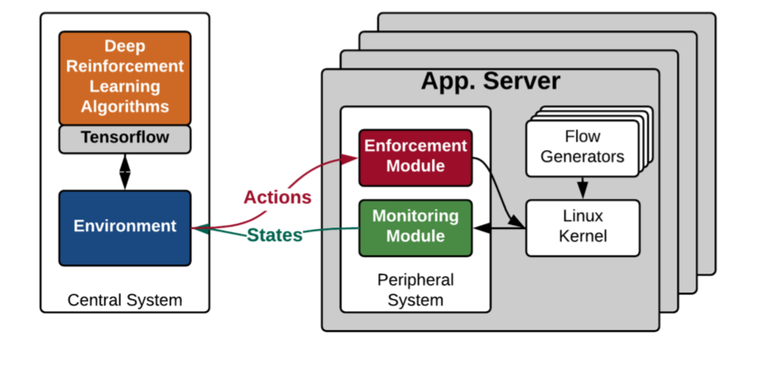
We design ATOM as a two-level system, mimicking the Peripheral and Central Nervous Systems in animals. As shown in Figure. Peripheral Systems (PS) run on all end-hosts, collect flow information, and make TO decisions locally with minimal delay for short flows. Central System (CS) makes individual TO decisions for long flows that can tolerate longer processing delays. Furthermore, PS’s decisions are informed by the CS where global traffic information are aggregated and processed.
Figure: ATOM Design Overview.

Slide 6
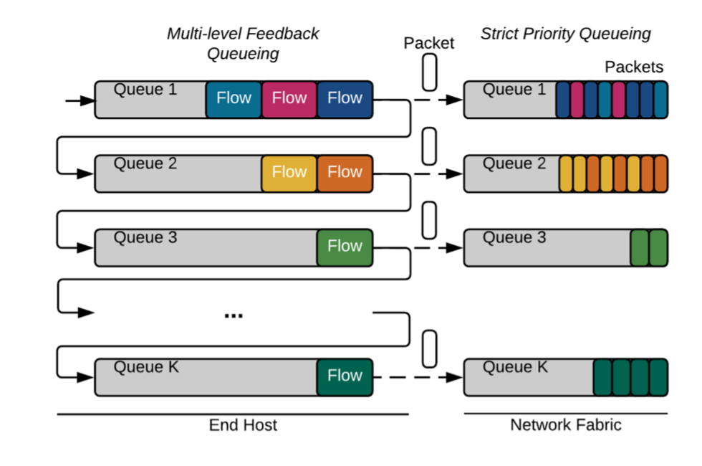
Peripheral System
The key to ATOM’s scalability is to enable PS to make globally informed TO decisions on short flows withonly local information. PS has two modules: an enforcement module and a monitoring module
Enforcement module to achieve the above goal, we adopt Multi-Level Feedback Queueing. Specifically, PS performs packet tagging in the DSCP field of IP packets attach end-host as shown in Figure. There are K priorities, Pi,1≤i≤K, and (K−1) demotion thresholds, αj,1≤ j≤K−1. W e configure all the switches to perform strict priority queueing based on the DSCP field.

Slide 7
Monitoring module For CS to generate thres- holds, the monitoring module collects flow sizes and completion times of all finished flows, so that CS can update flow size distribution. The monitoring module also reports on-going long flows that have descended into the lowest priority on its end-host, so that CS can make individual decisions.
Central System
The CS is composed of two RL agents (RLA): short flow RLA (sRLA) is for optimizing thresholds for MLFQ, and long flow RLA (lRLA) is for determining rates, routes, and priorities for long flows. sRLA attempts to solve a FCT minimization problem, and we develop a Random Forest Regression and K-means clustering algorithms for this purpose. For lRLA, we use a Thompson Sampling algorithm to generate actions for the long flows. In the next section, we describe the two RL problems and solutions.

Slide 8
Random Forest Regression
A Random Forest is an ensemble technique capable of performing both regression and classification tasks with the use of multiple decision trees and a technique called Bootstrap Aggregation, commonly known as bagging.
Decision tree builds regression models in the form of a tree structure. It breaks down a dataset into smaller and smaller subsets while at the same time an associated decision tree is incrementally developed. The final result is a tree with decision nodes and leaf nodes. A decision node (e.g., Outlook) has two or more branches (e.g., Sunny, Overcast and Rainy), each representing values for the attribute tested. Leaf node (e.g., Hours Played) represents a decision on the numerical target. The topmost decision node in a tree which corresponds to the best predictor called root node. Decision trees can handle both categorical and numerical data.

Slide 9
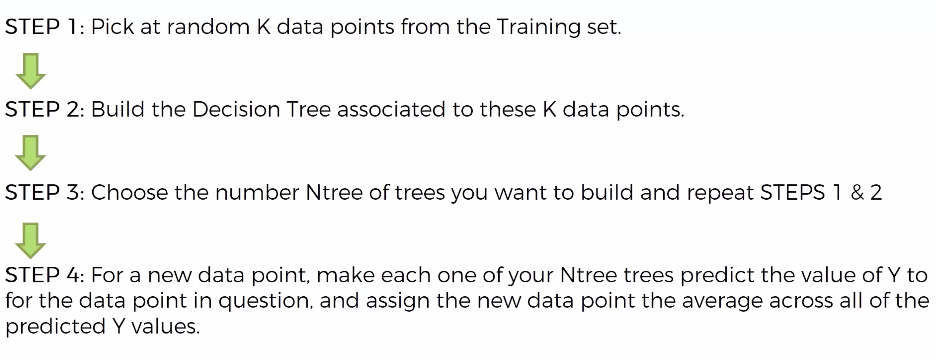
Procedure for Random forest regression

Slide 10
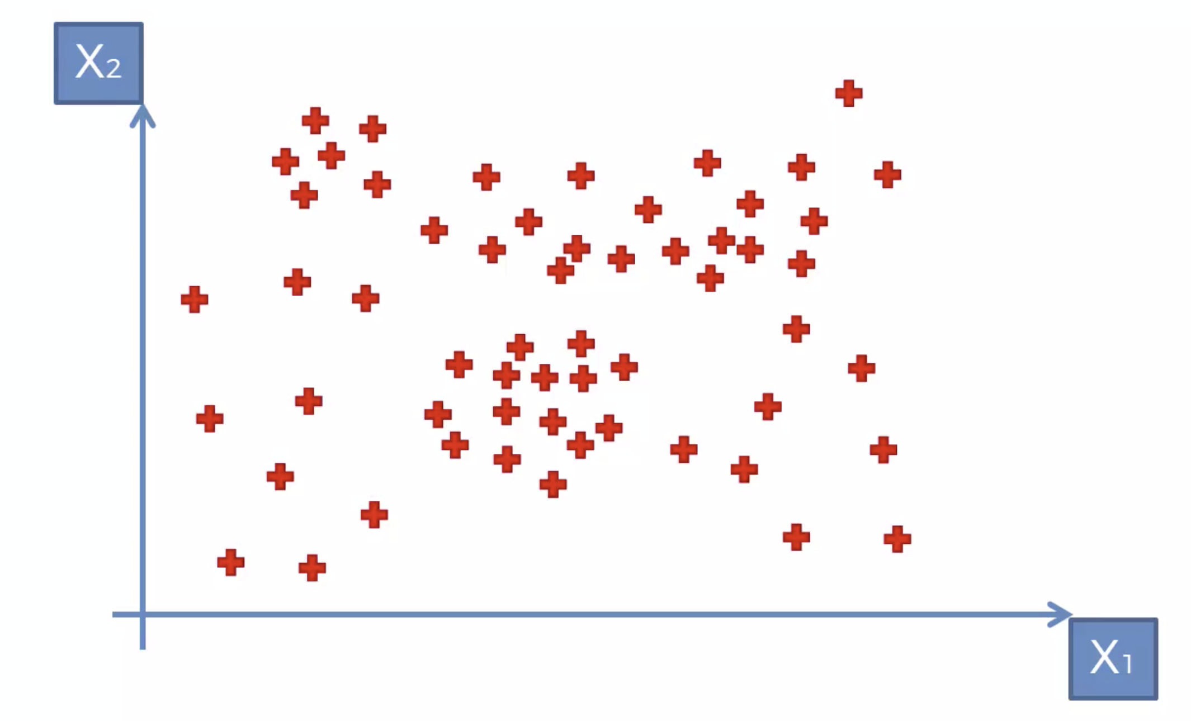
Consider a Set of points as shown in figure as the packets of data coming to a data-center

Slide 11
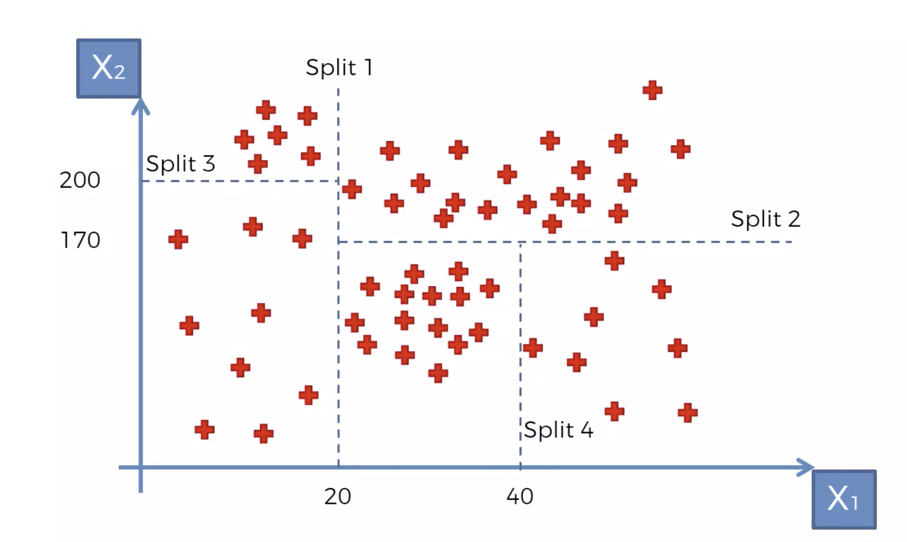
The Algorithm will now split the given packets into particular number(in this 4) of parts randomly. Now based on the new packet came into the router, then the decision tree will answer its value in the following fashion.

Slide 12
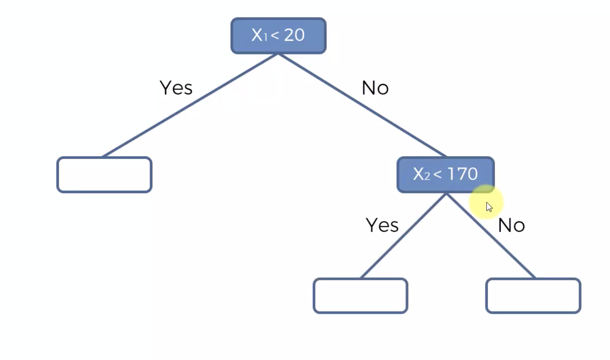
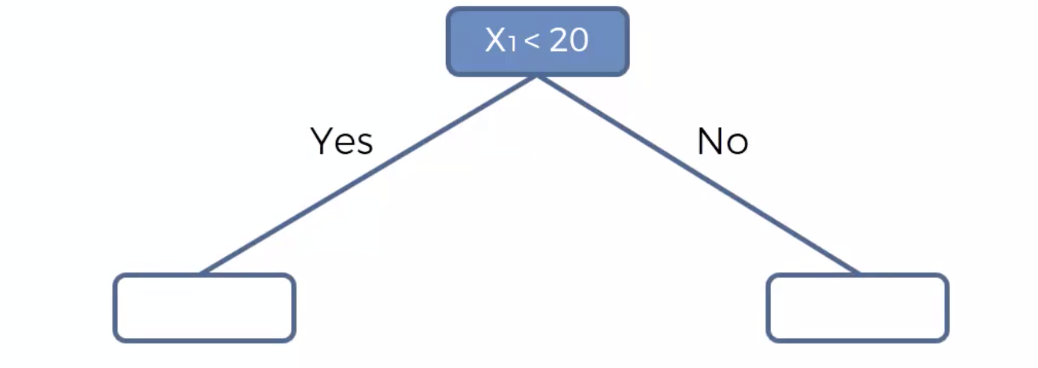
Let us take an example of the packet entered have data of 30bytes and entered a queue of buffer size 50. The decision tree answers its value as.

Slide 13
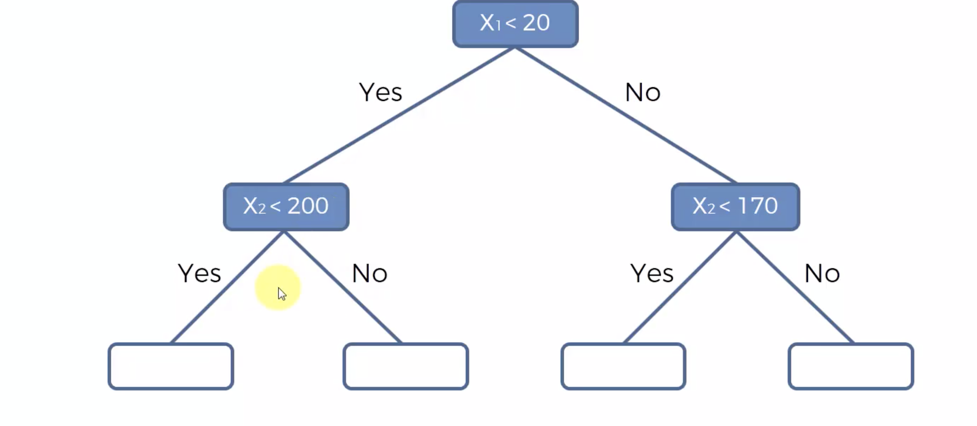
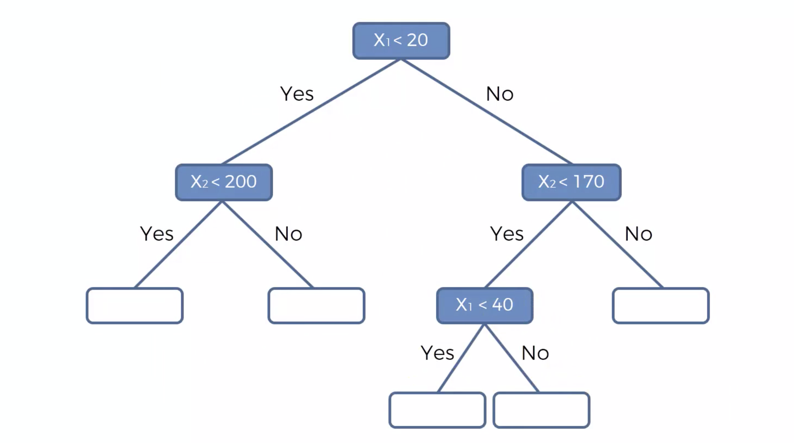
The Algorithm will build a tree like shown in the figure.
Figure

Slide 14
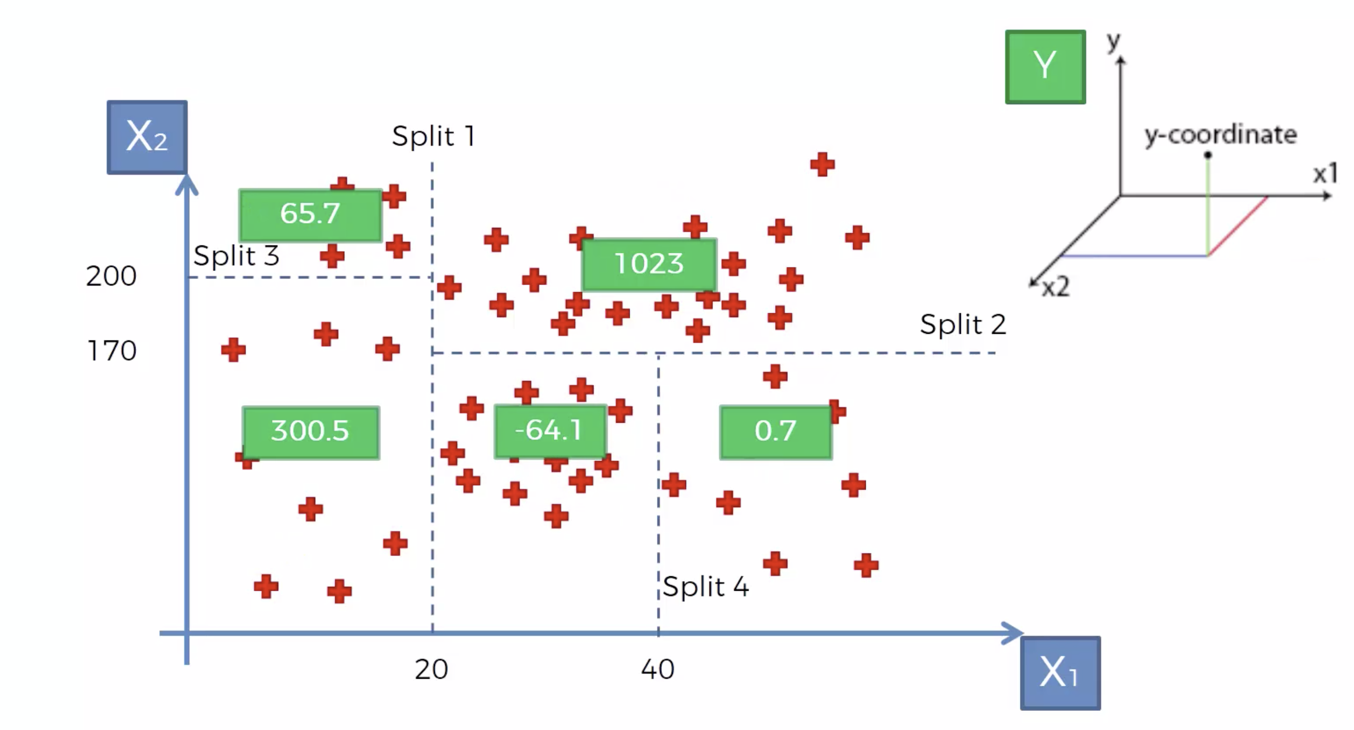
Now After the completion of decision tree the algorithm will find the averages of the values in each subset. The values here are just for example.

Slide 15
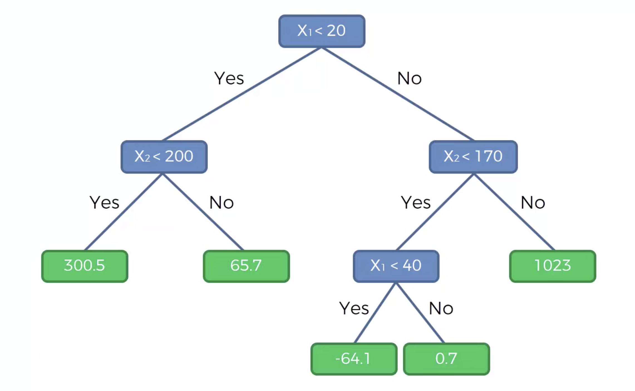
Now the tree will be completed by filling the empty boxes in Figure as shown below.

Slide 16
This is the working of one decision tree and in the Random forest Algorithm there can be few hundreds to few millions of trees. Based on the no of trees the accuracy will be improved drastically..
Here, each tree in the forest will give one prediction each, at last the algorithm will give the average of all tree’s predictions.

Slide 17
K-means clustering
K-means clustering is one of the simplest and popular unsupervised machine learning algorithms.
A cluster refers to a collection of data points aggregated together because of certain similarities.
You’ll define a target number k, which refers to the number of centroids you need in the dataset. A centroid is the imaginary or real location representing the center of the cluster.
Every data point is allocated to each of the clusters through reducing the in-cluster sum of squares.

Slide 18
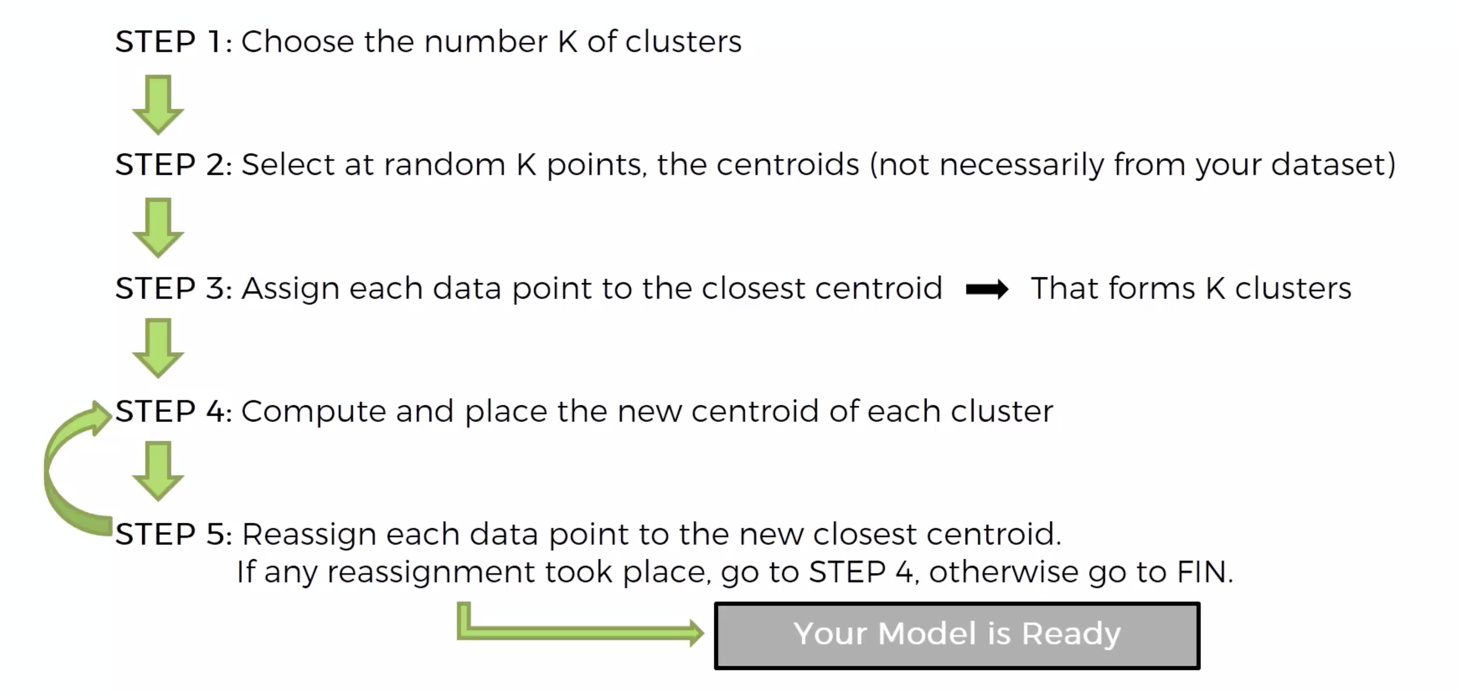
Procedure for the k-means clustering algorithm.

Slide 19
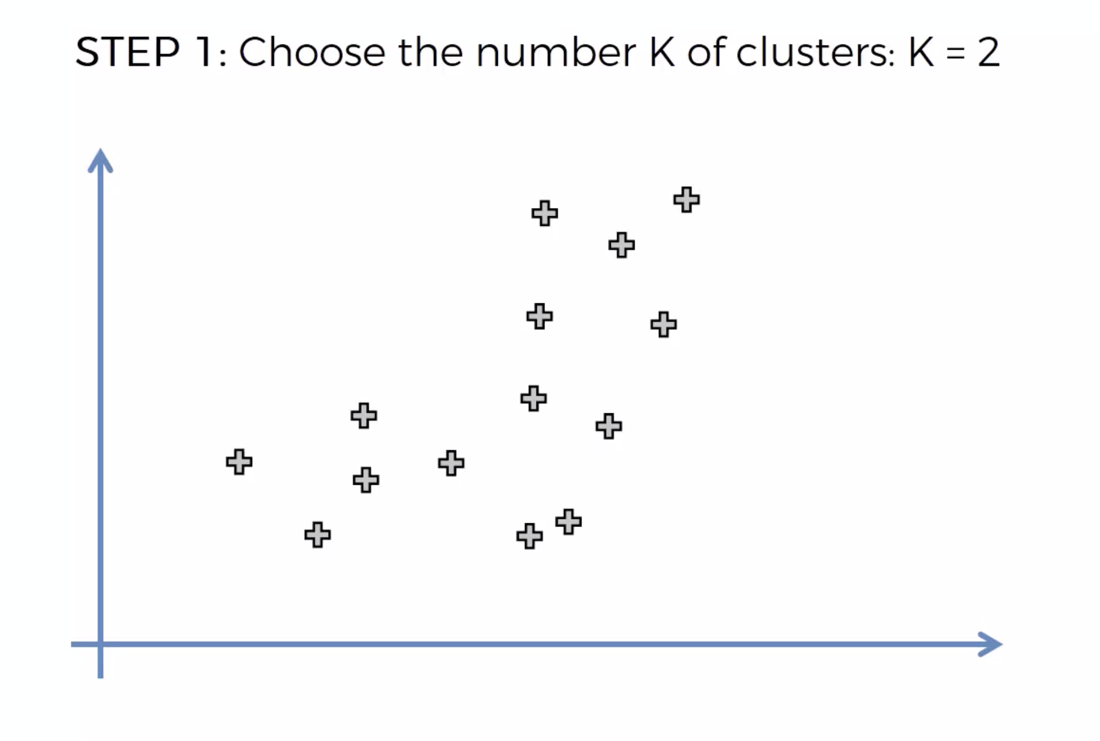
Lets look at the working of k-means clustering using following example.

Slide 20
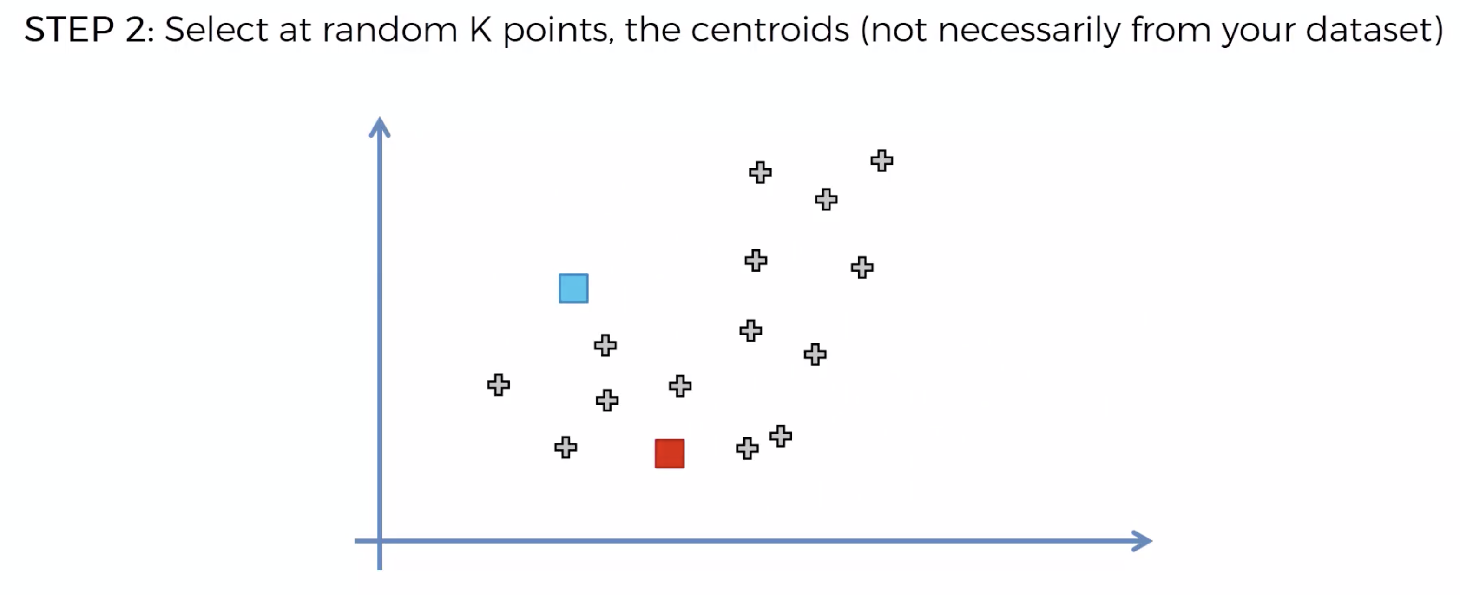

Slide 21
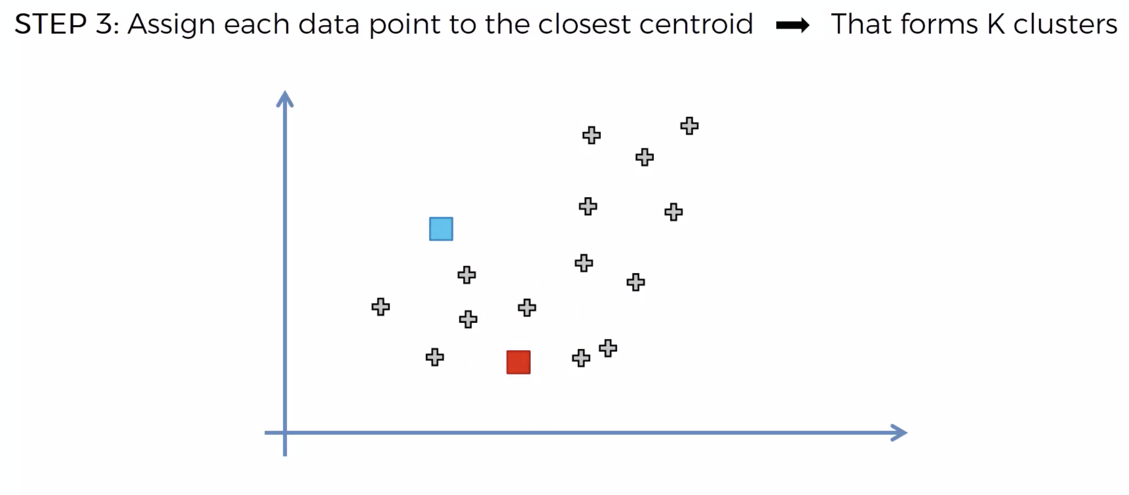

Slide 22
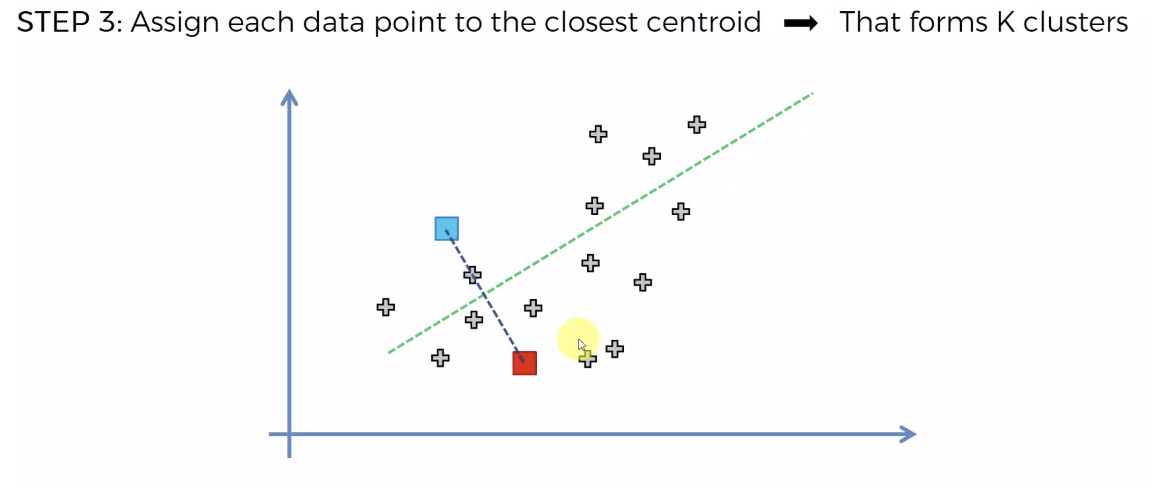

Slide 23
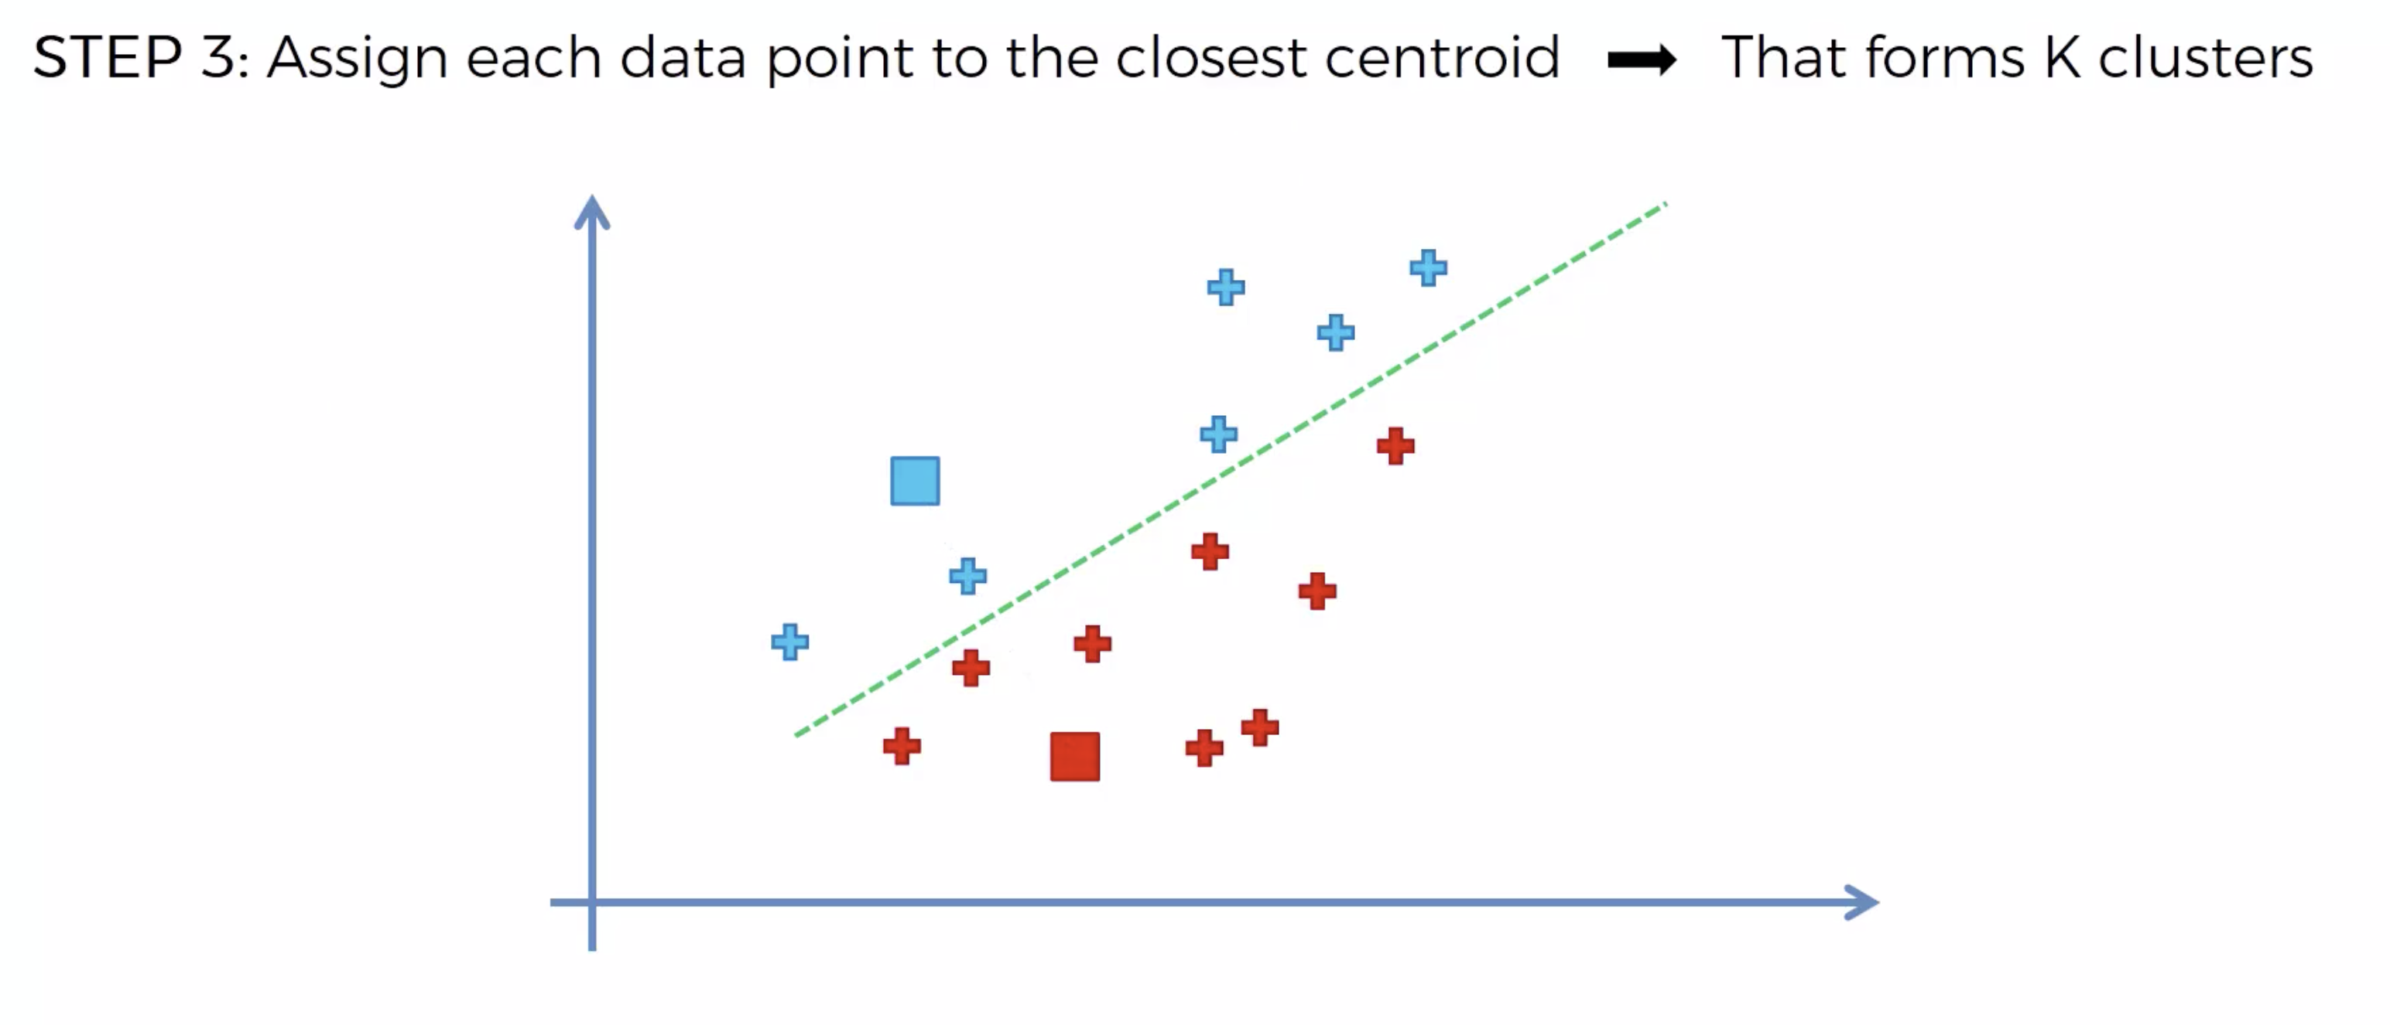

Slide 24
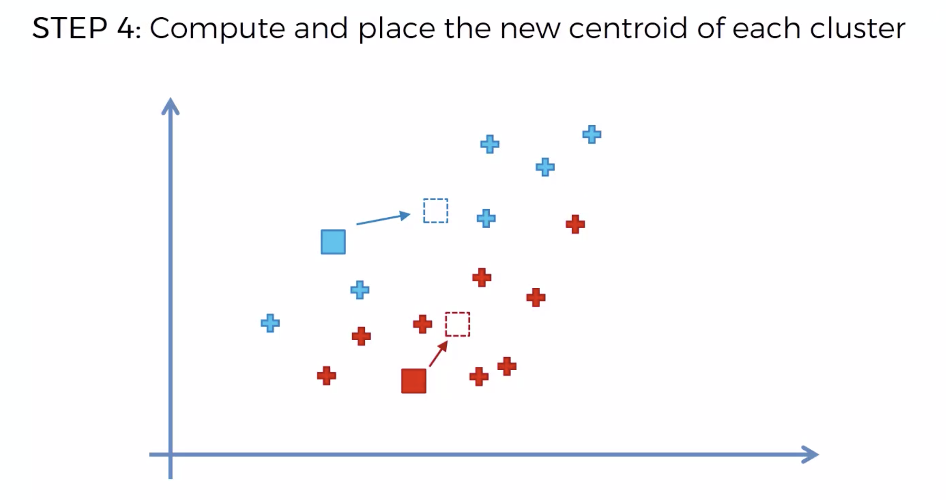

Slide 25
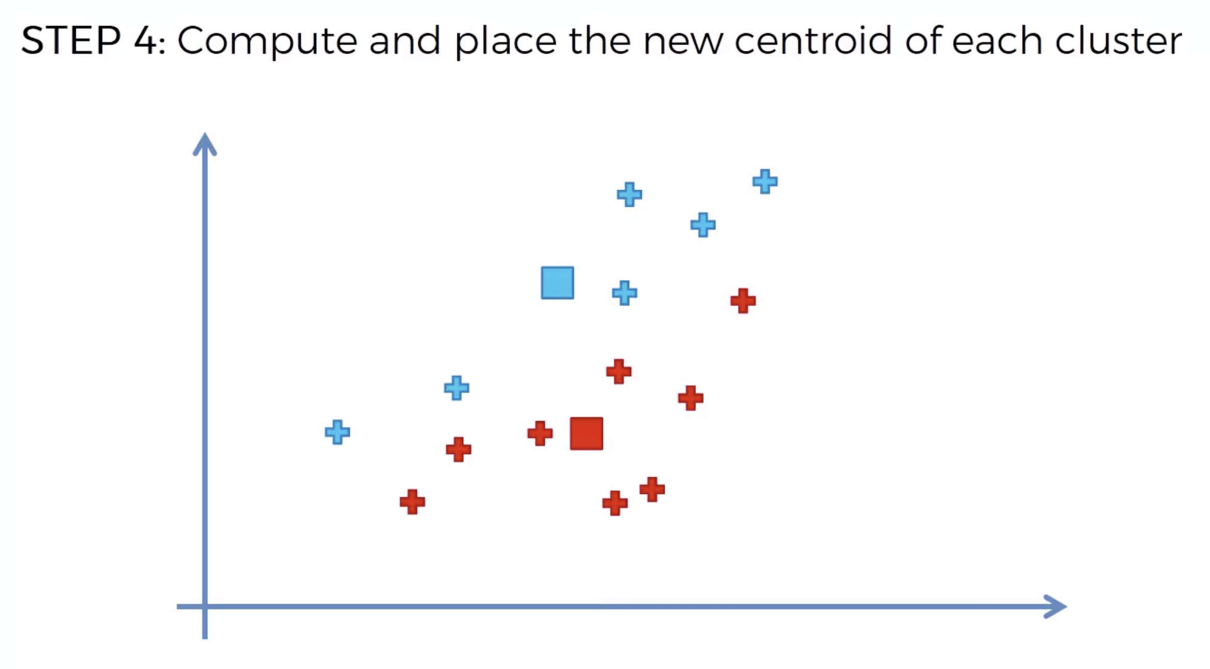

Slide 26
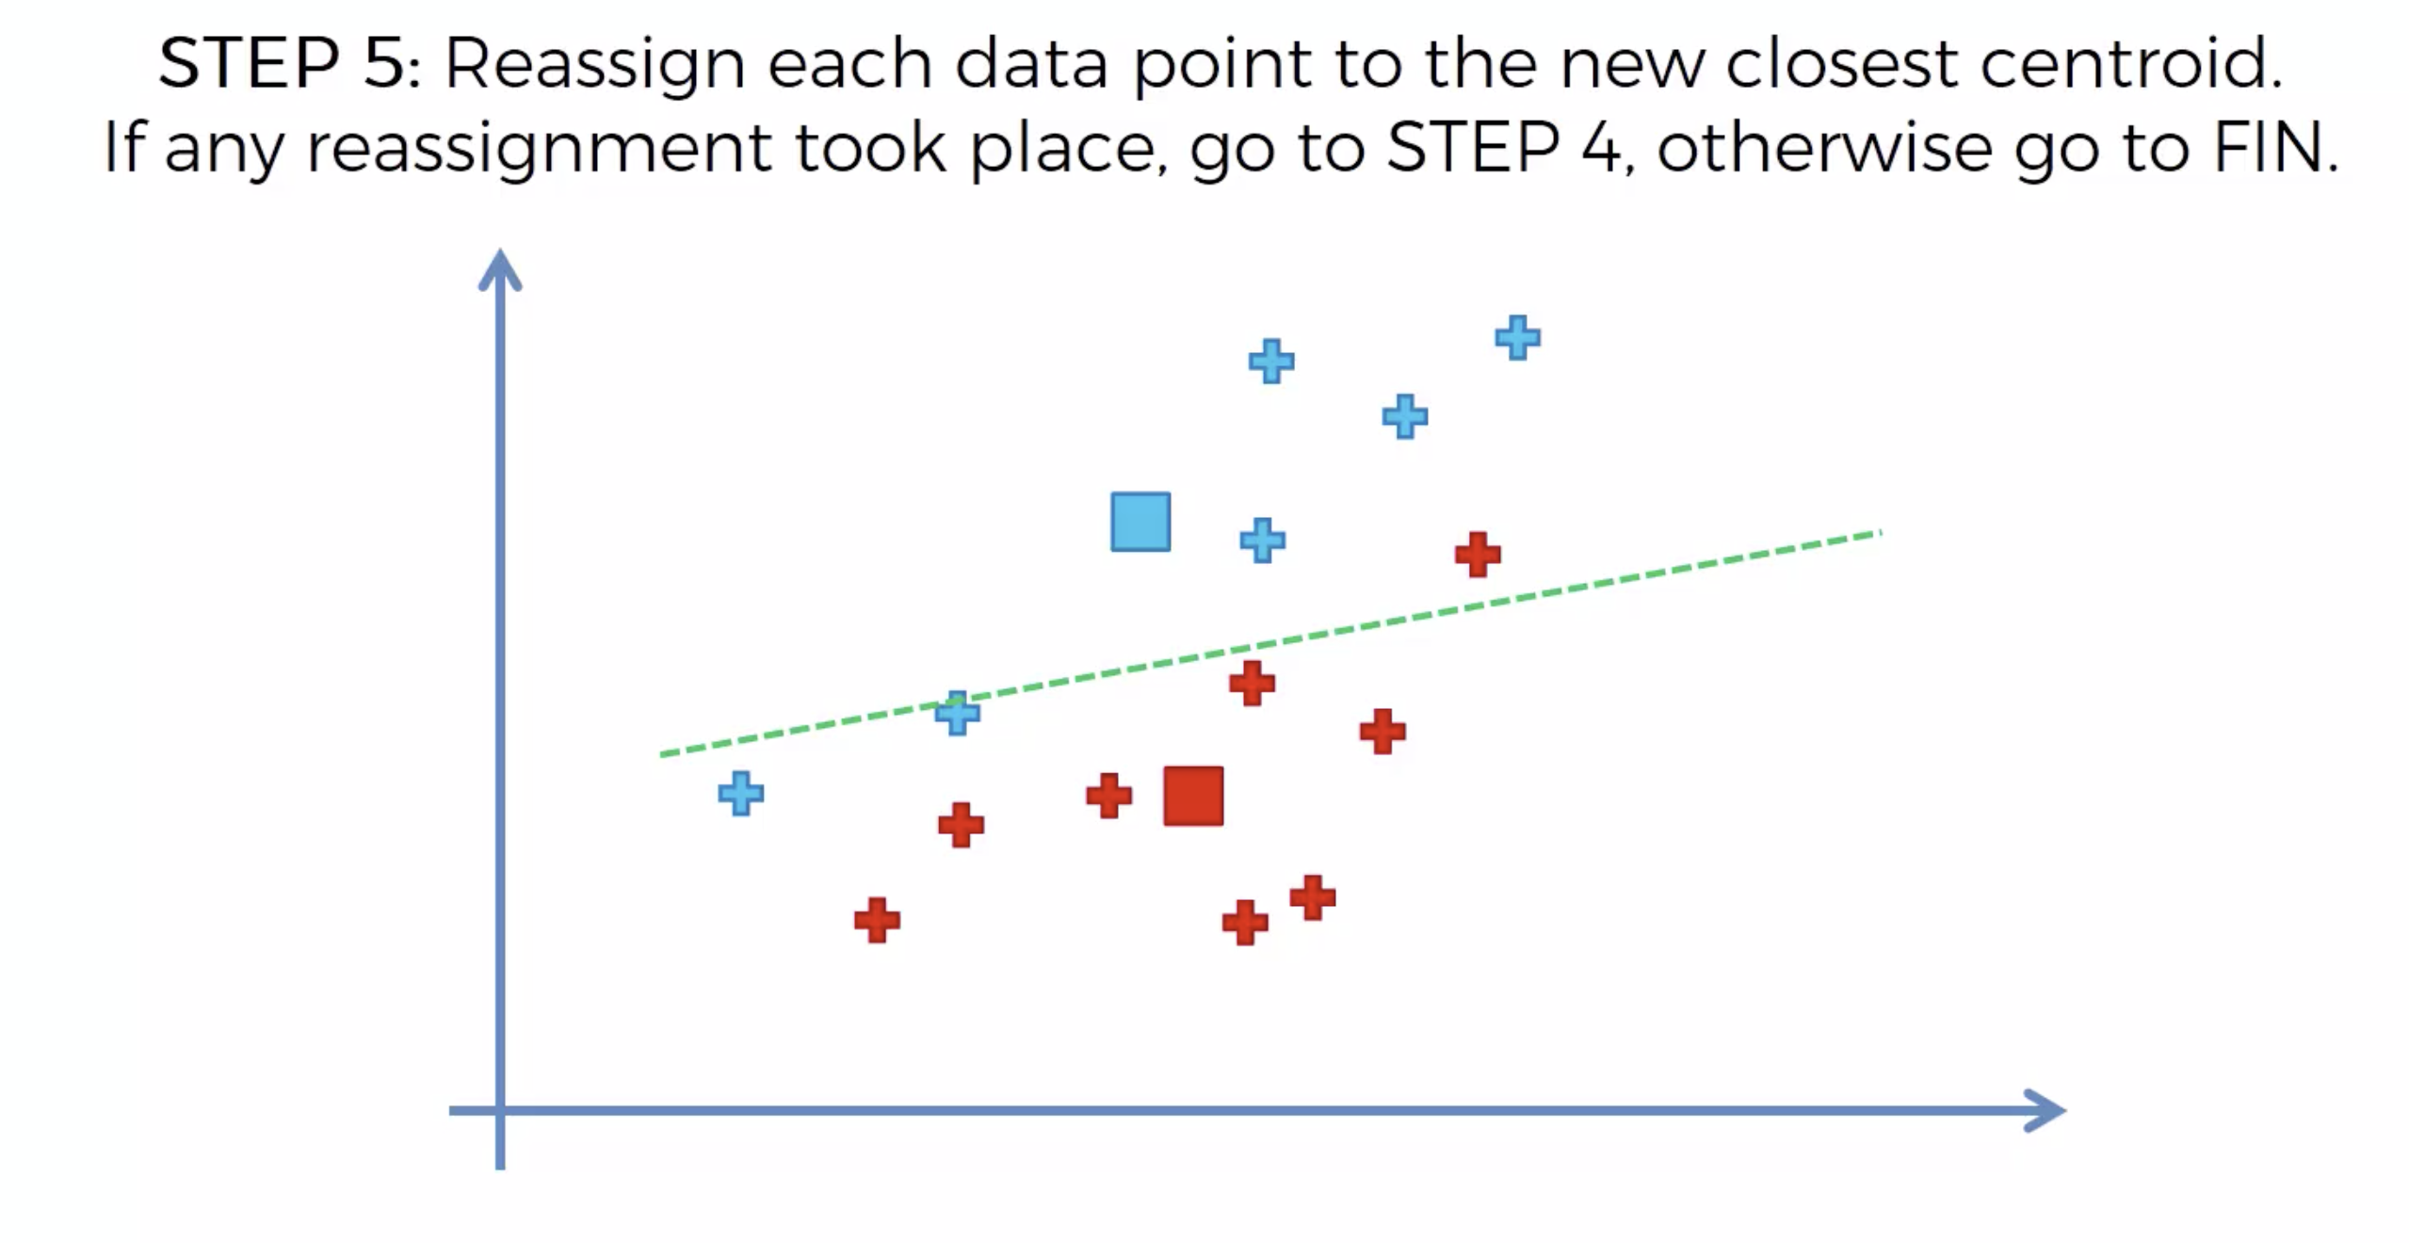

Slide 27
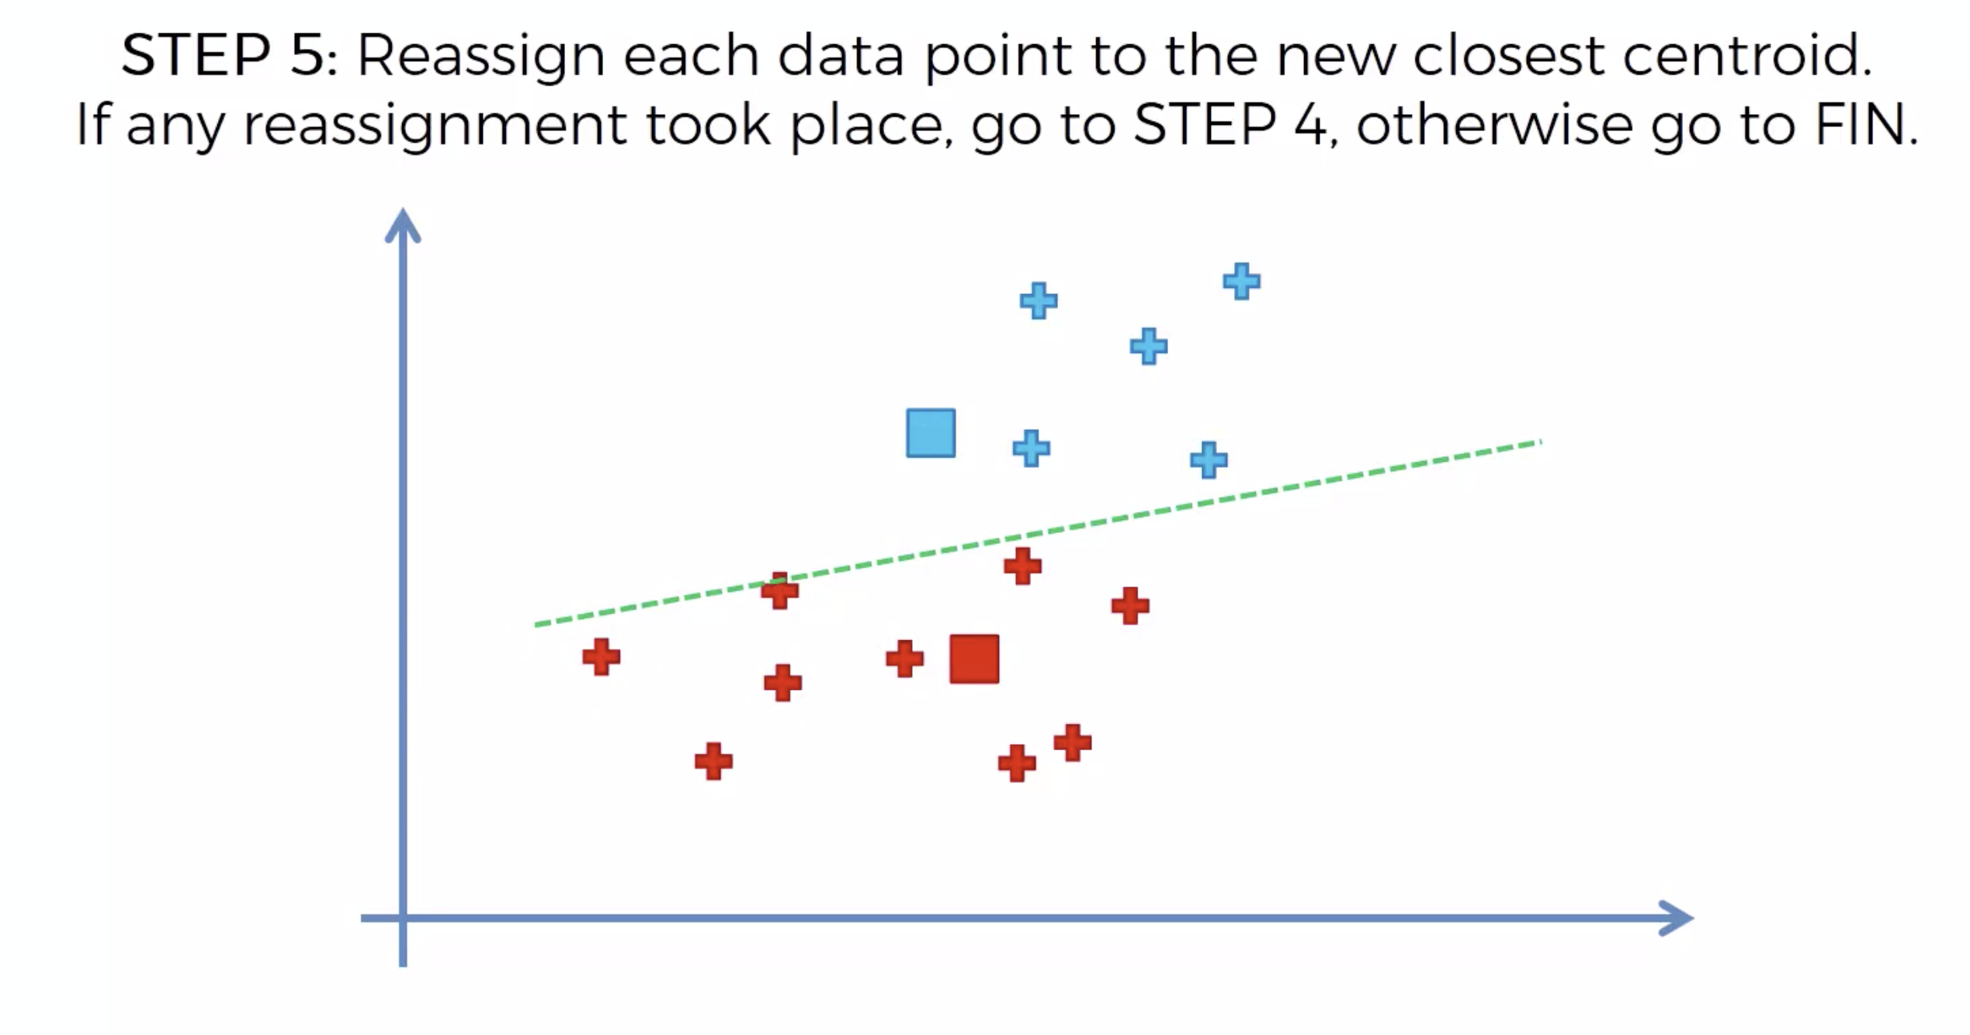

Slide 28
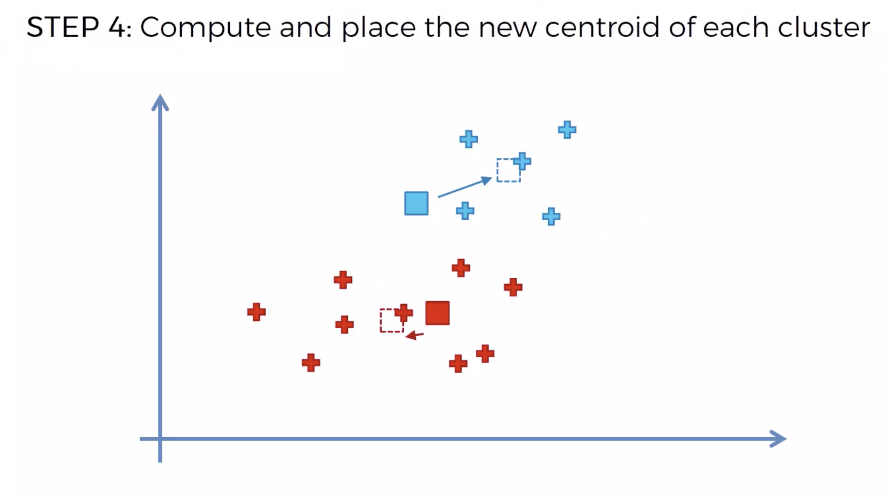

Slide 29
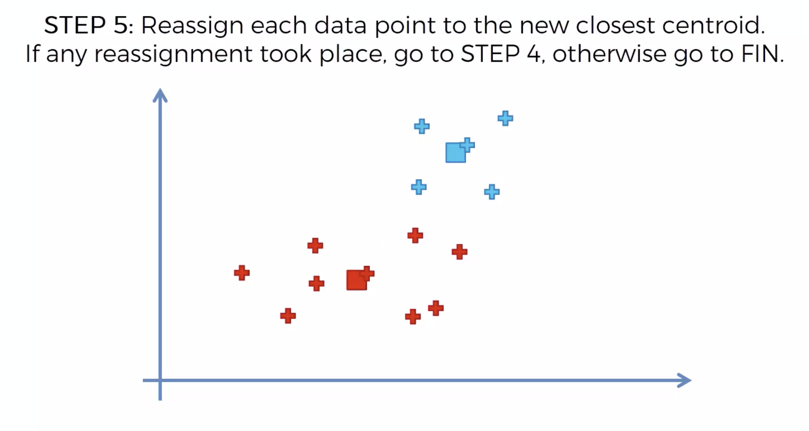

Slide 30
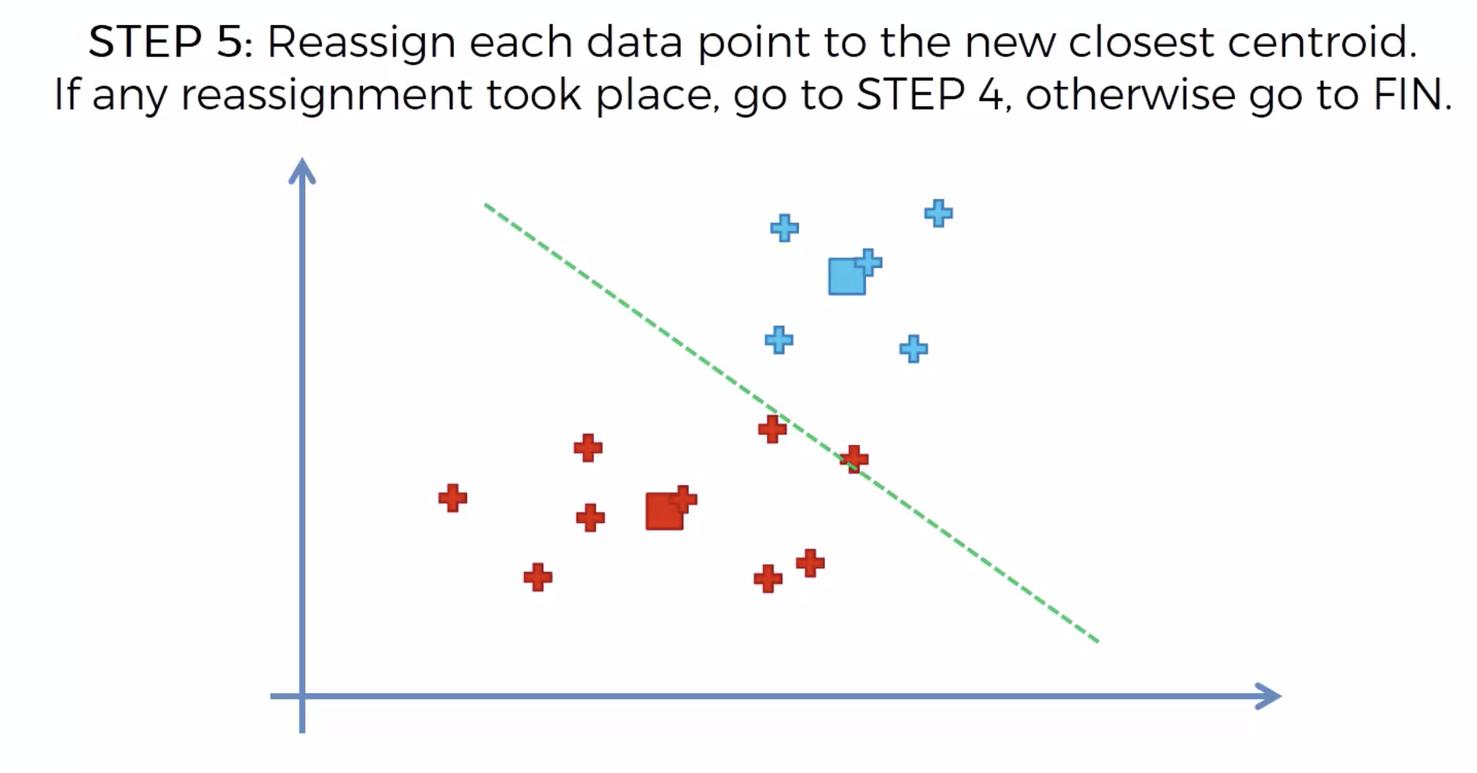

Slide 31
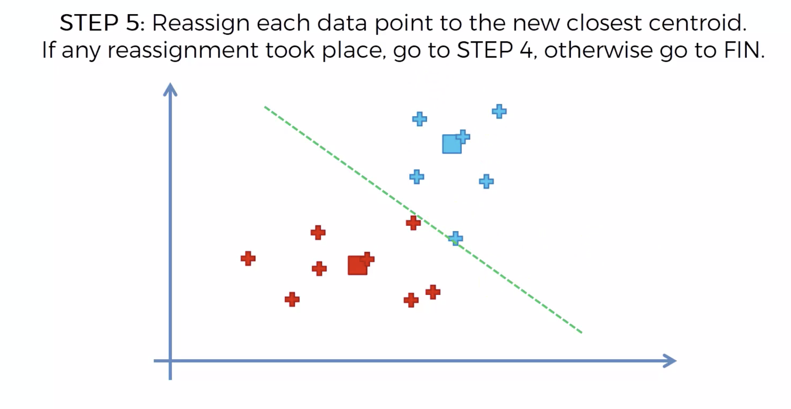

Slide 32
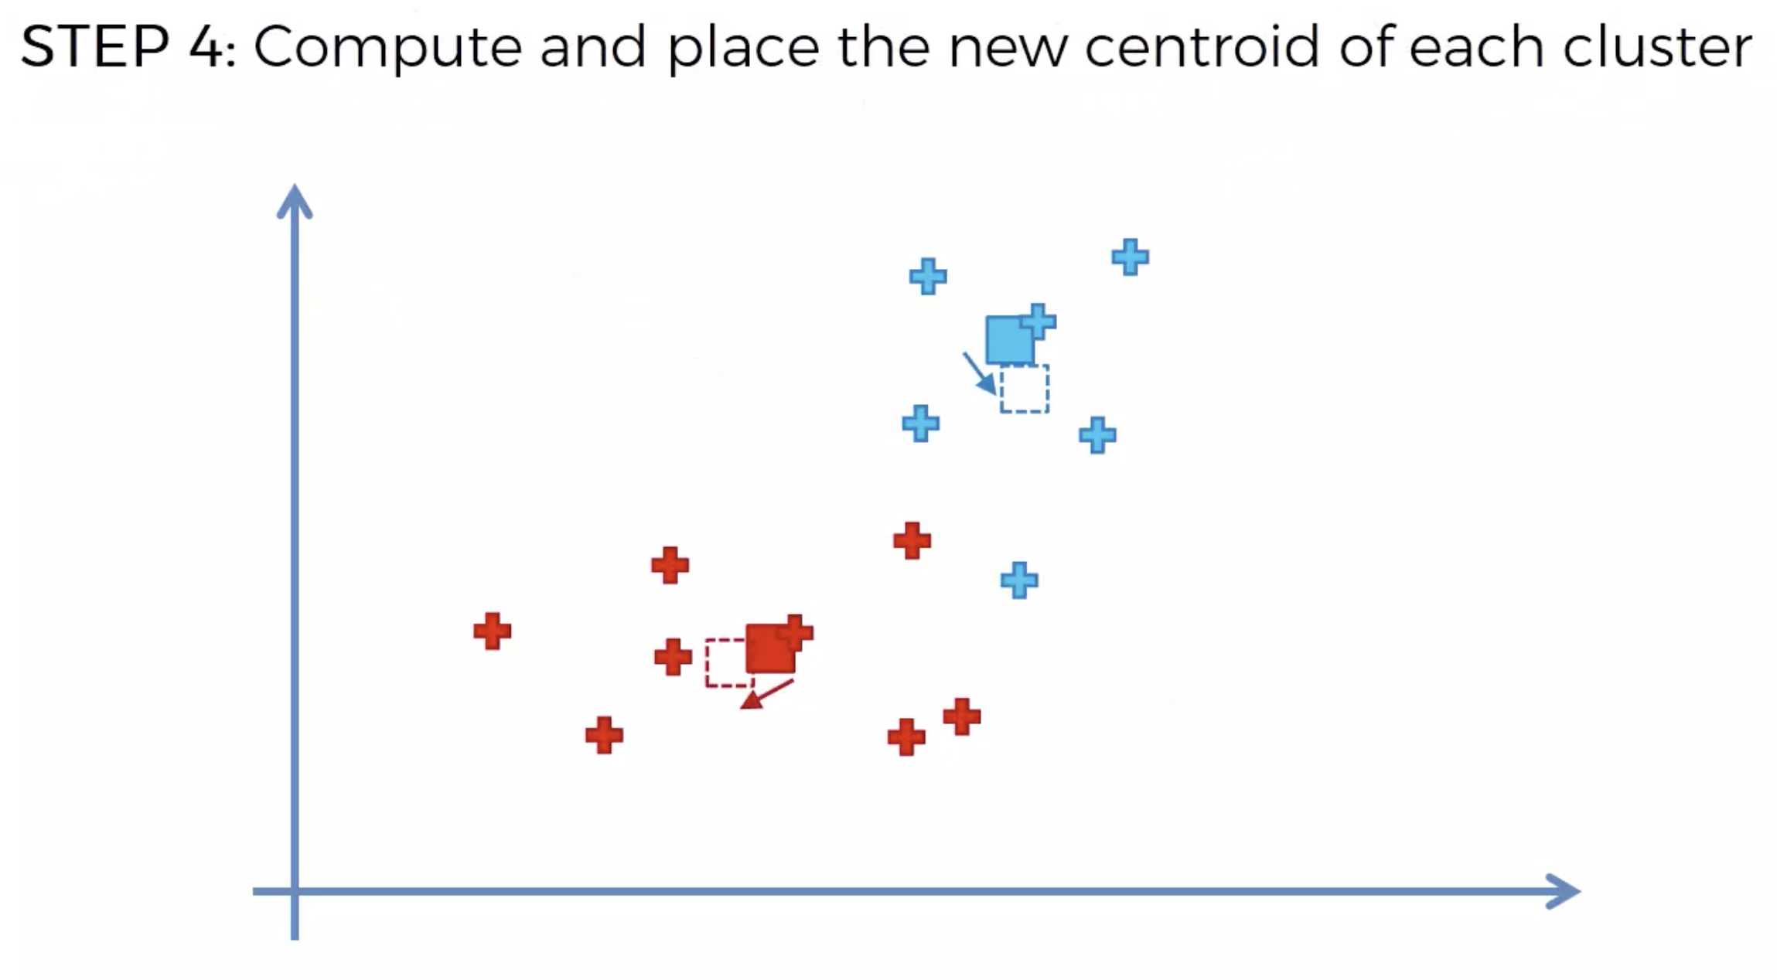

Slide 33
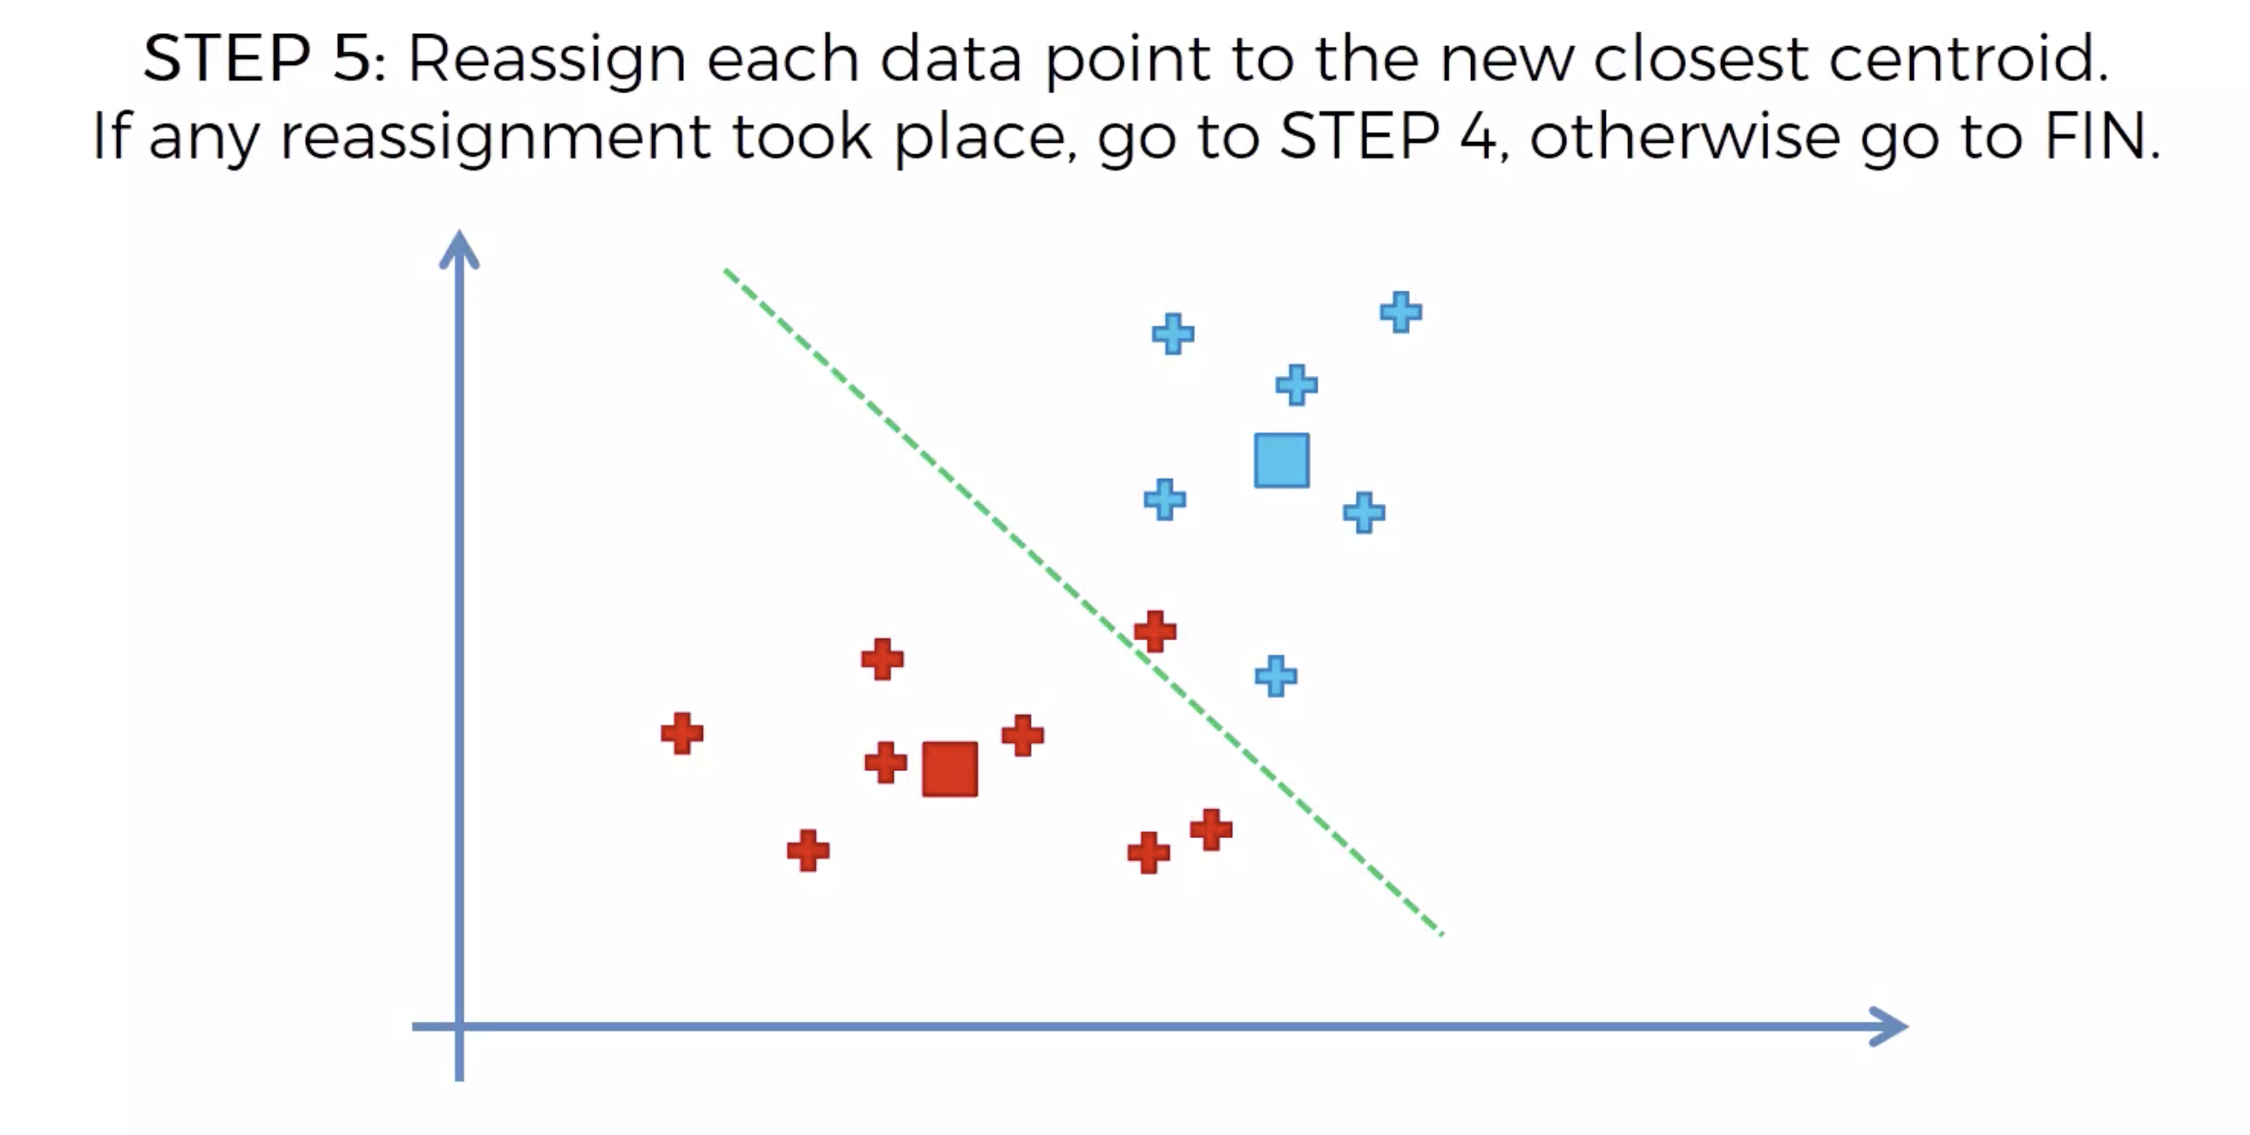

Slide 34
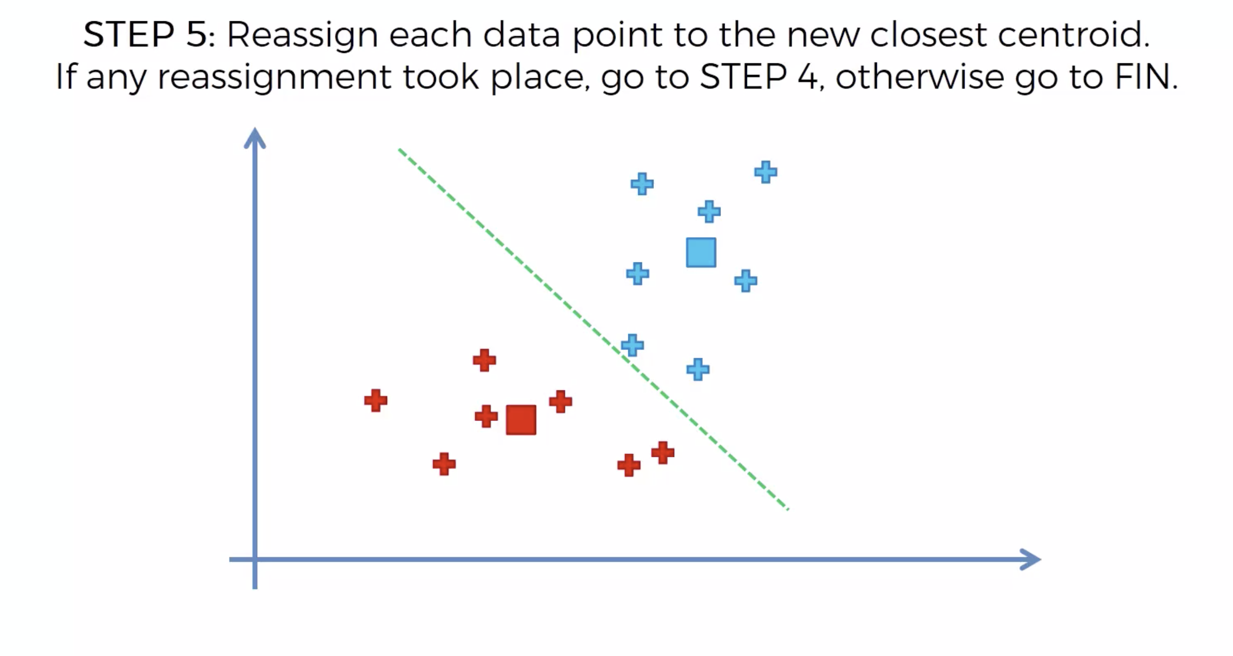

Slide 35
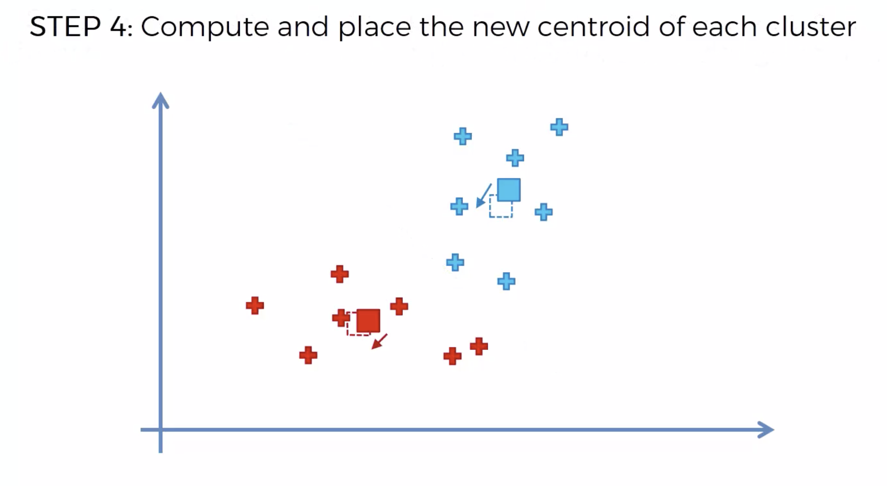

Slide 36
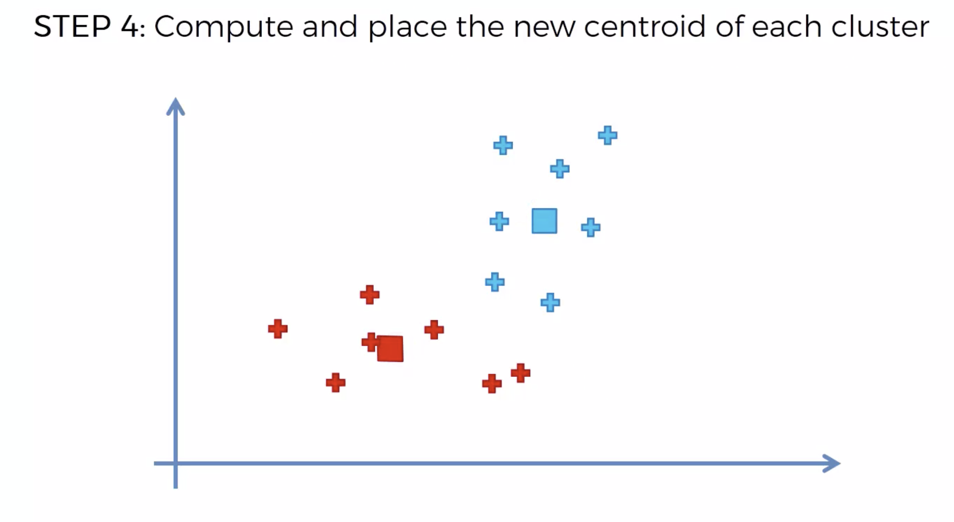

Slide 37
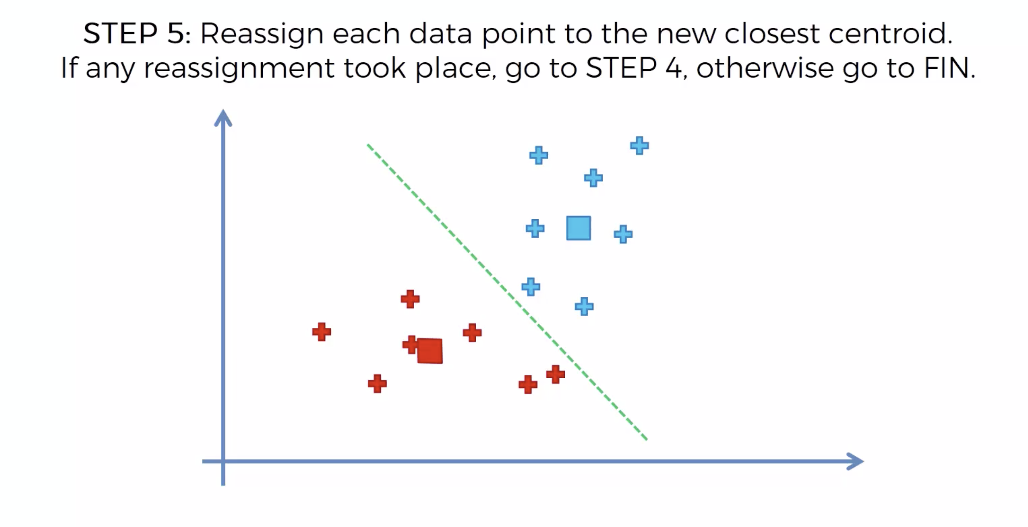
So, Here we can say that the clustering algorithm is done.

Slide 38
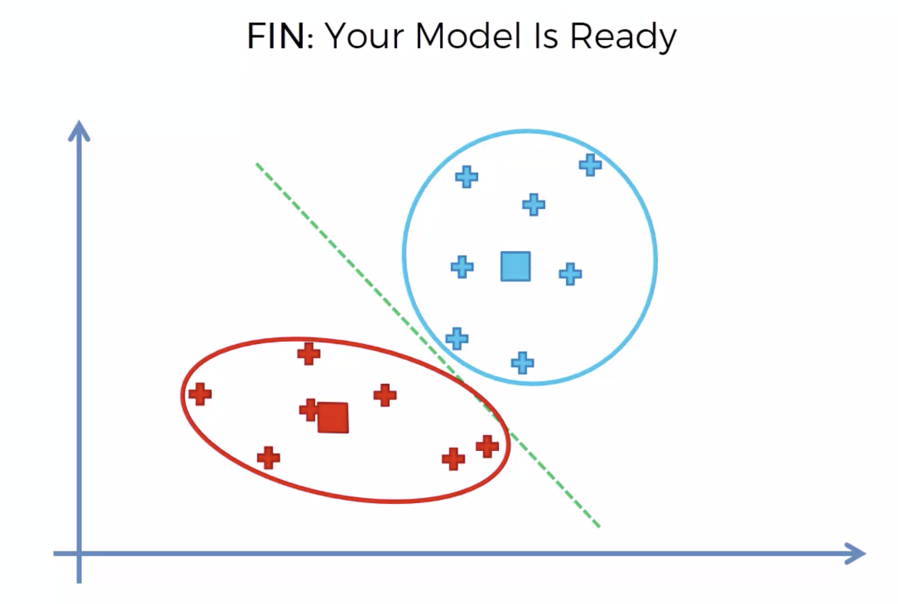
The end figure looks like shown in figure.
This way we can sort our regressed packets into their respective routers.

Slide 39
Thompson Sampling
In Machine Learning, Thompson sampling, named after William R. Thompson, is a heuristic for choosing actions that addresses the exploration-exploitation dilemma in the Multi-Armed-Bandit problem. It consists in choosing the action that maximizes the expected reward with respect to a randomly drawn belief.
Here, We try to recreate the distribution for a particular router in this situation.

Slide 40
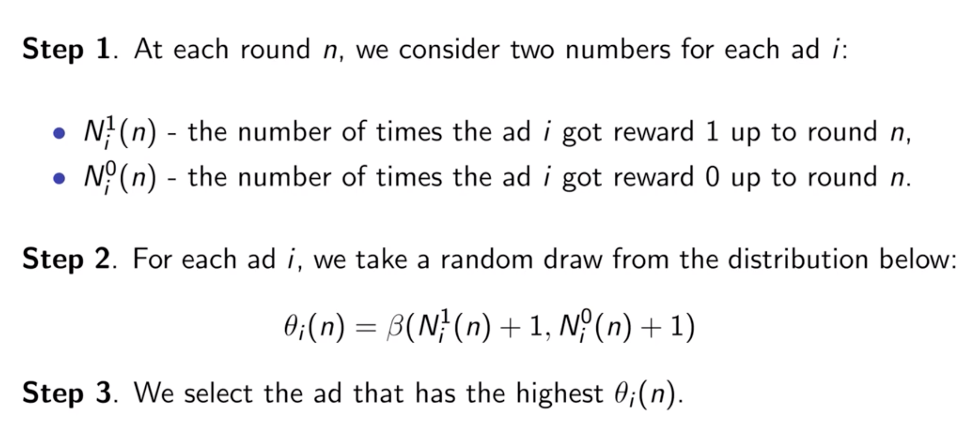
Procedure for the Thompson Sampling.

Slide 41
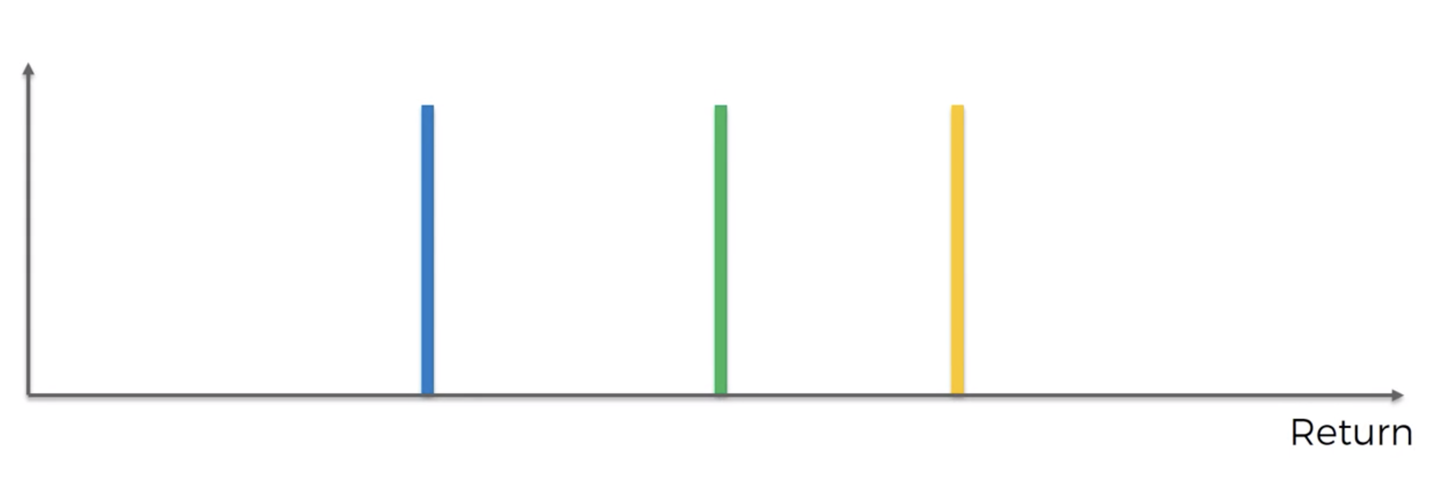
Lets have a closer look at this complex Reinforcement learning algorithm with the following example. The three lines in the figure shows the optimal router positioning for the particular packet.

Slide 42
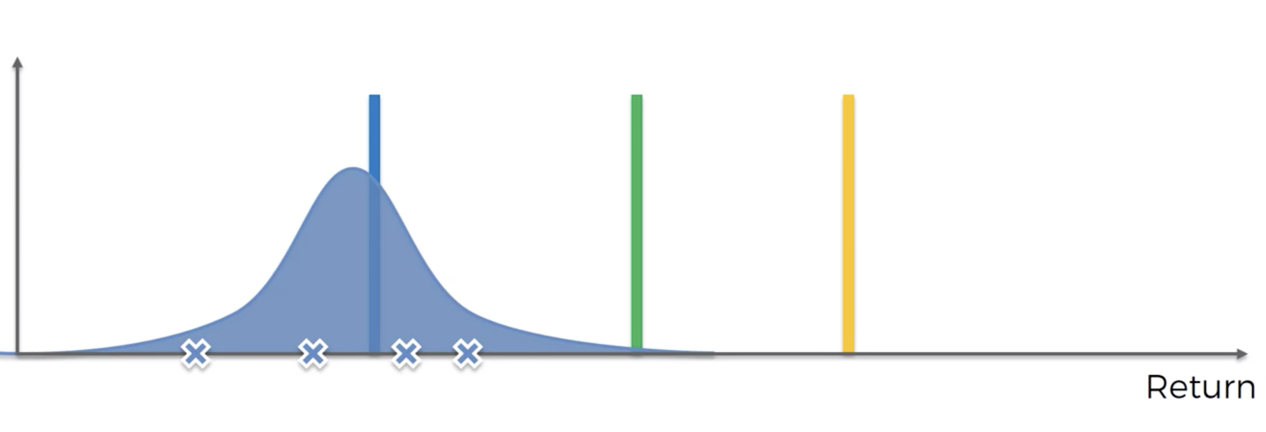
Here, for the reference, we will choose some random packets from the data and try to match it with the reference lines shown in the figure. But in real case scenario, we doesn’t have any kind of clue or anything we will just try to get the optimum result for the given packet to the given router.

Slide 43
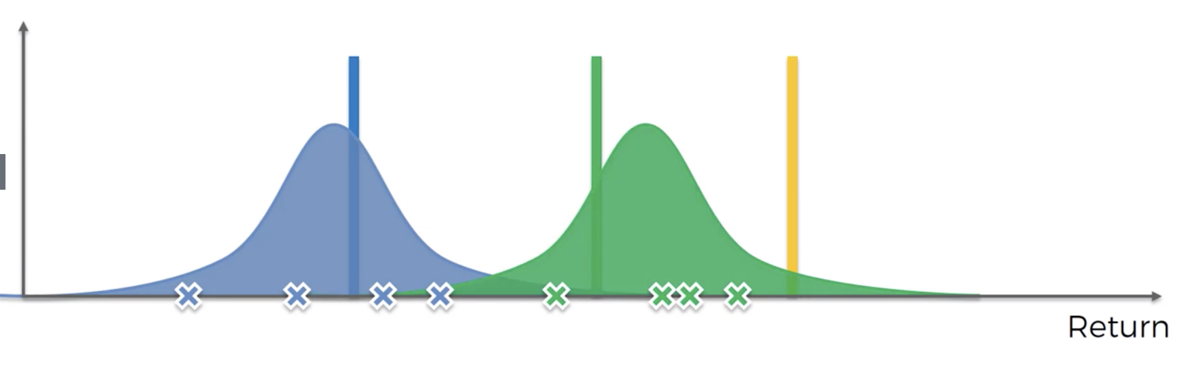
Similarly for the other one.

Slide 44
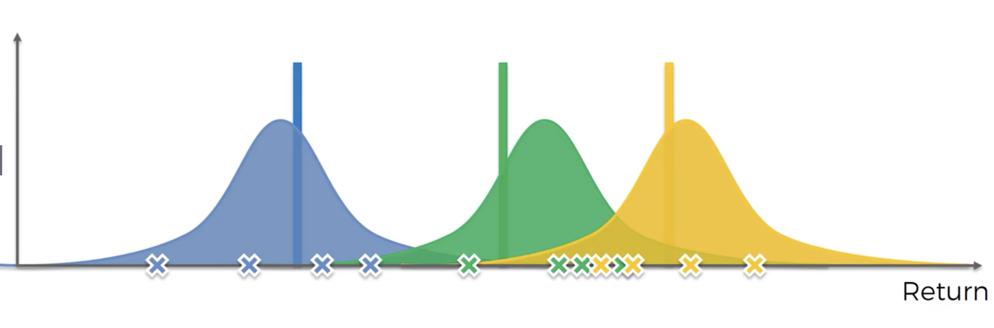
Similarly for the last one.

Slide 45
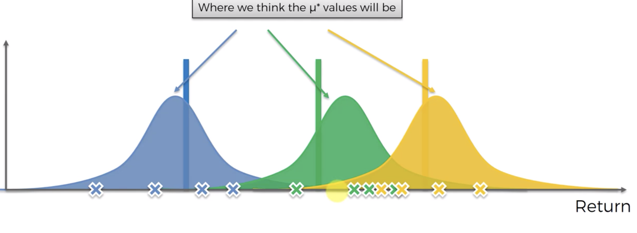
Now we will try to guess where the means of the following distribution lie

Slide 46
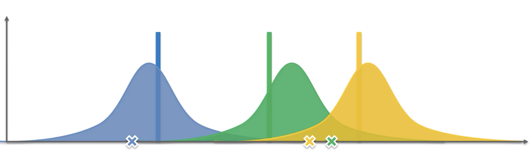
Lets assume those as our randomly selected means.
Here green gives the largest return.
So Green is adjusted as follows.

Slide 47
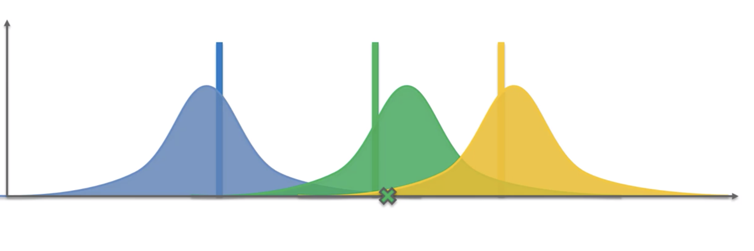
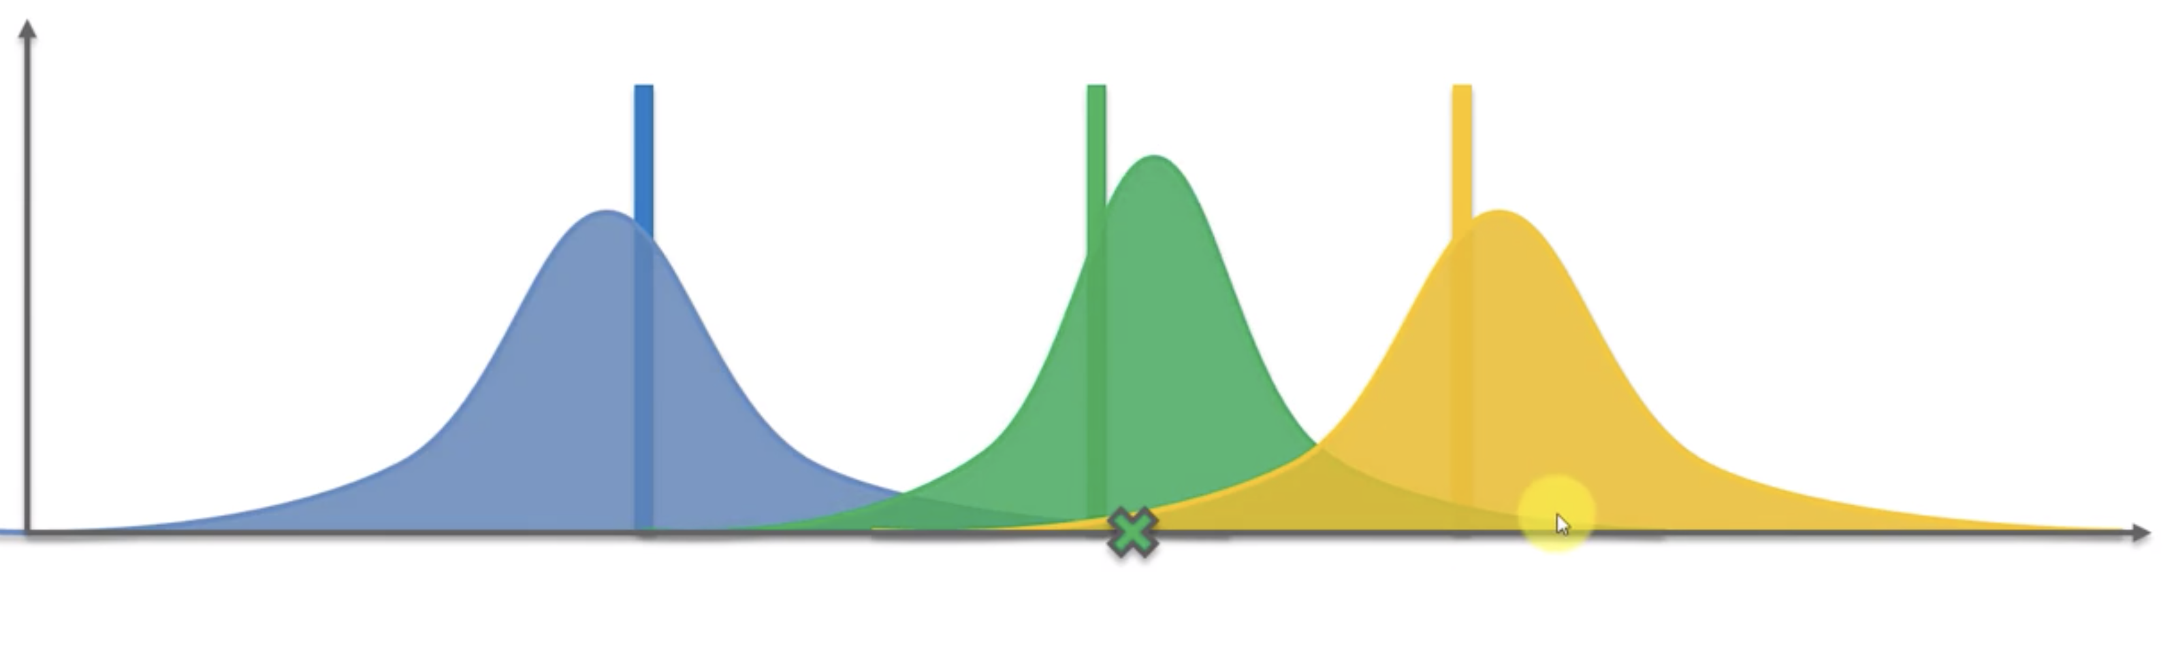

Slide 48
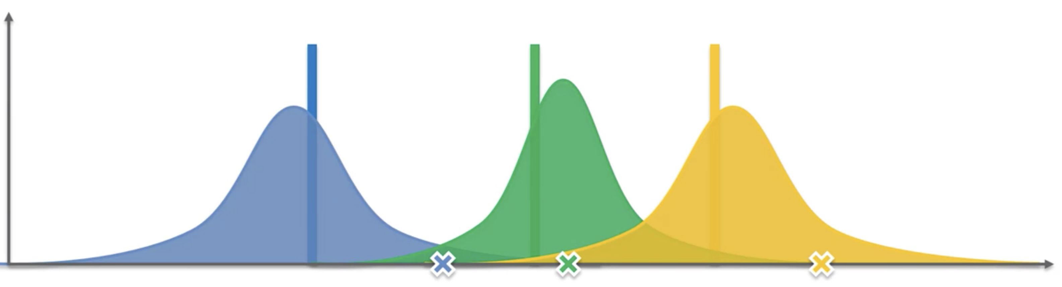
Now these are our randomly selected means.
Here yellow gives the largest return.
So Yellow is adjusted as follows.

Slide 49
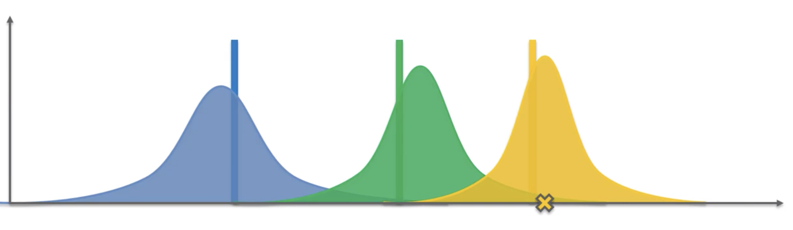
The following process will be done many times such that one of the following router’s distribution dominates the other.

Slide 50
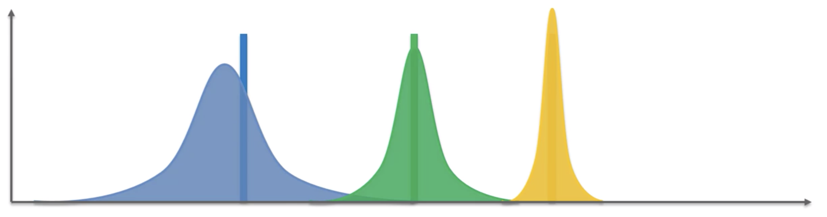
Here the distribution of the yellow one dominated the other . . .
In this case, So Yellow one the ideal router for the particular data flow.
As the Thompson Sampling uses the distribution curve as reference, So we can say that this is a probabilistic method reinforcement learning.

Slide 51
Implementation
We have implemented the code in python and used libraries that are built into the python to make our task easier.
First, we have searched for the dataset for a data center and finally got one, which describes the following:
It is a routing table from one PARTICULAR IP to another IP via data center having 10 routers.
It has the 10,000 packet routing history of that particular transaction.
Now, We have given a priority for each packet and sorted them based on the priority by using a Priority Queue. We sent the resulting dataset to our Central System that decides whether it is a small data flow or large data flow depending on the size of packet. Here, we used sorting technique to do so namely merge sort. Sorted it in ascending order and given the preference to shorter data.

Slide 52
The code for this project is in GitHub. Link: https://github.com/surya1304/CN_Project
Here just the results are shown.
Future work of converting this Machine learning Model into a Deep Learning Model is in progress.

Slide 53
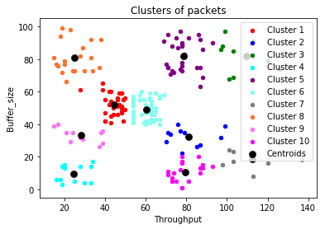
This is the result of the short data flows using random forest and k-means clustering algorithm.

Slide 54
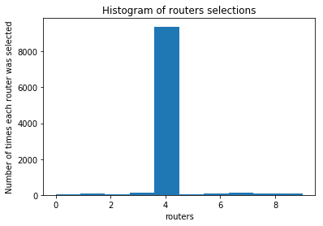
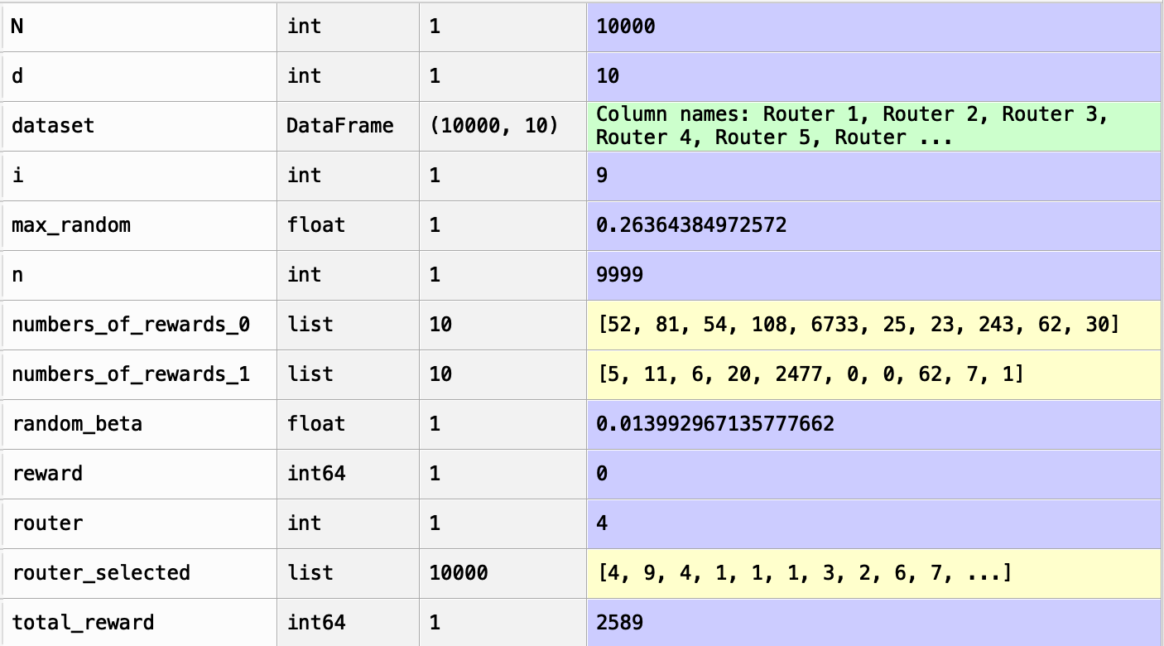
The Results of the Thompson Sampling.
First is that the 5th one(as in python indexing start from 0) is the best routing path for the given long data flow.
Second, shows that the total reward of 2589 out of 10000 which is 25.89% of the output.
Note: As the values are generated randomly the total reward may change each time we execute it. But its mean value will be around 2500 or 25%.

Slide 55
As this Project is for data centers, I can’t prove it practically but I am sure that my code will work as solid as it sounds in the real world as well.

Slide 56
Thank You, Hope you like it! A special thanks to Rahul Pandya sir, for giving the freedom to select the project and motivating us for making this project, a successful one.
Feel free to share your thoughts and improvements that can be done in this project.

